Slide 1



Energetic Particle Acceleration in the Heliosphere from the IMAP mission
Eric R. Christian
NASA Goddard Space Flight Center
…on behalf of the entire IMAP Team
36th ICRC, 2019
SH6d

Slide 2
Mission Overview
IMAP addresses 2013 Decadal Survey high priority science goals for Remotely Mapping the Outer Heliosphere and Understanding Particle Acceleration in the Heliosphere
IMAP extends prior outer heliosphere ENA measurements with much higher sensitivity/resolution than IBEX and INCA & coordinated observations of Suprathermal and Energetic Particles needed to study particle acceleration
Supporting measurements of solar wind ions, electrons, magnetic field, as well as interstellar dust and solar wind structure from EUV observations
IMAP utilizes a small, sun pointed, spin-stabilized spacecraft in orbit about L1 as pioneered by ACE
Notes:
Combine two whitepapers:
Interstellar Mapping Probe (McComas et al., WP #188)
Particle Acceleration and Transport in the Heliosphere, PATH (Desai, Christian et al., WP #56)
Interstellar Mapping & Acceleration Probe
SSP DS Rec 3.0
Restructure STP as a Moderate-Scale, PI-led mission line
IMAP highest priority for next STP

Slide 3
Comprehensive Science Payload
Notes:
Combine two whitepapers:
Interstellar Mapping Probe (McComas et al., WP #188)
Particle Acceleration and Transport in the Heliosphere, PATH (Desai, Christian et al., WP #56)
Interstellar Mapping & Acceleration Probe
SSP DS Rec 3.0
Restructure STP as a Moderate-Scale, PI-led mission line
IMAP highest priority for next STP

Slide 4
Key Measurement Parameters
IMAP-Lo: 10-1000 eV ISN/ENA fluxes & composition
IMAP-Hi: 0.4-15.6 keV ENA fluxes & composition
IMAP-Ultra: 3-300 keV ENA fluxes & composition
MAG: 2 Hz (128 Hz intervals) w/ 10 pT resolution
SWE: 1-5000 eV electron f(v) @ 15 s
SWAPI: 0.1-20 keV/q SW ions & PUIs @ 15s
CODICE-Lo: SW/PUI/ST ions 3 to 60 amu, <0.5-80 keV/q
CODICE-Hi: ST/EP ions 1 to >60 amu, 0.03-5 MeV/nuc
HIT: EP dE/dX vs E H-Fe ions 2-40 MeV/nuc & electrons
IDEX: Dust composition 1-500 amu w/ m/Δm>200
GLOWS: H(Ly-a) glow – SW, ionization, Rad P
Notes:
Combine two whitepapers:
Interstellar Mapping Probe (McComas et al., WP #188)
Particle Acceleration and Transport in the Heliosphere, PATH (Desai, Christian et al., WP #56)
Interstellar Mapping & Acceleration Probe
SSP DS Rec 3.0
Restructure STP as a Moderate-Scale, PI-led mission line
IMAP highest priority for next STP

Slide 5
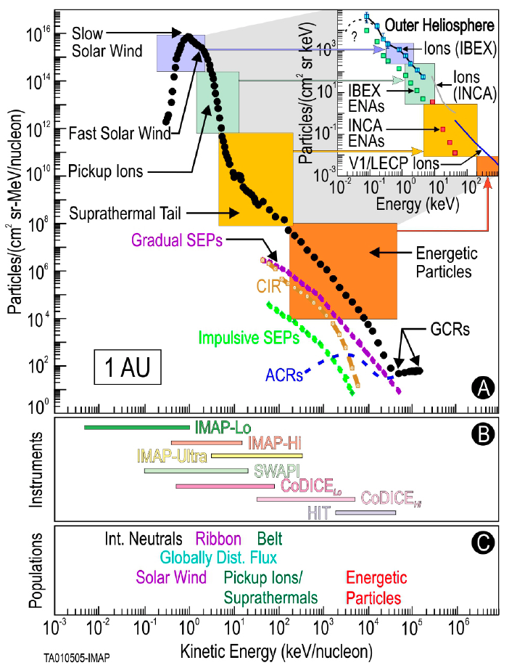
Critical Particle Acceleration Observations
Explores fundamental link between origins of particle acceleration and global interactions of SW with LISM
Measures energy distributions of ENAs, suprathermals, pickup ions, and EPs to disclose the physical processes that control acceleration of suprathermal particles at 1 AU and heliosheath
Ion fluxes in the Voyager 1 direction (top) from in situ and remote ENA observations
SWAPI, CoDICE, HIT: comprehensive ion composition, energy, and angular distributions

Slide 6
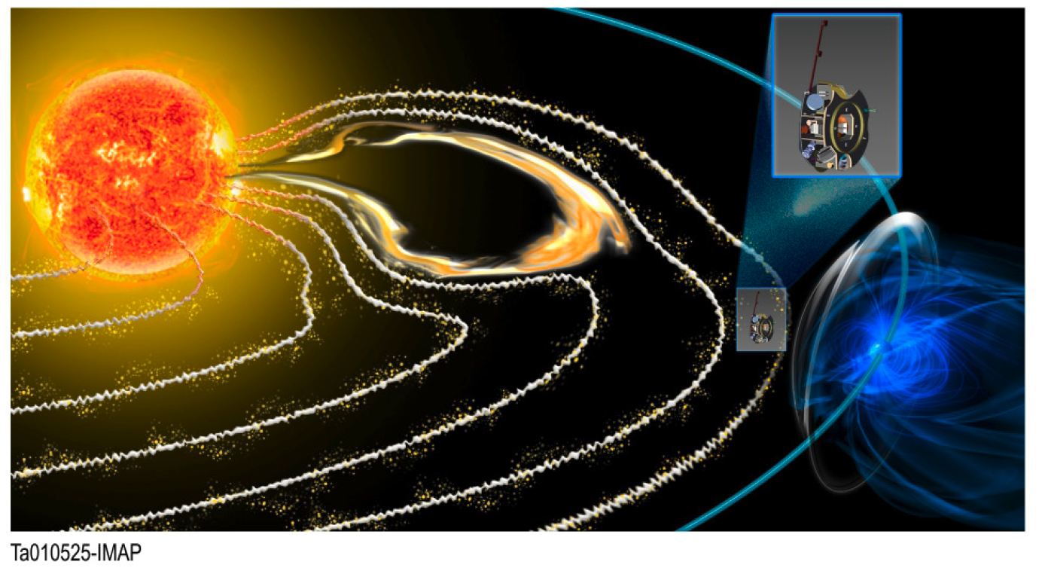
Particle Acceleration
SEPs – critical scientific importance:
Solar energetic particle studies are:
of broad interest due to their relevance to the question, “how are charged particles accelerated and transported?”
of particular interest due to their impact on Earth and space systems (Space Weather)
3 Important Questions:
How is Suprathermal Tail Energized?
How are Energetic Particles Accelerated?
How does Transport Affect the Observations?
Main Areas for Observational Improvement:
Better (higher cadence measurements) of the Suprathermal tail.
Better Microphysics Observations (not IMAP)
Multipoint measurements (including IMAP)
Notes:
Combine two whitepapers:
Interstellar Mapping Probe (McComas et al., WP #188)
Particle Acceleration and Transport in the Heliosphere, PATH (Desai, Christian et al., WP #56)
Interstellar Mapping & Acceleration Probe
SSP DS Rec 3.0
Restructure STP as a Moderate-Scale, PI-led mission line
IMAP highest priority for next STP

Slide 7
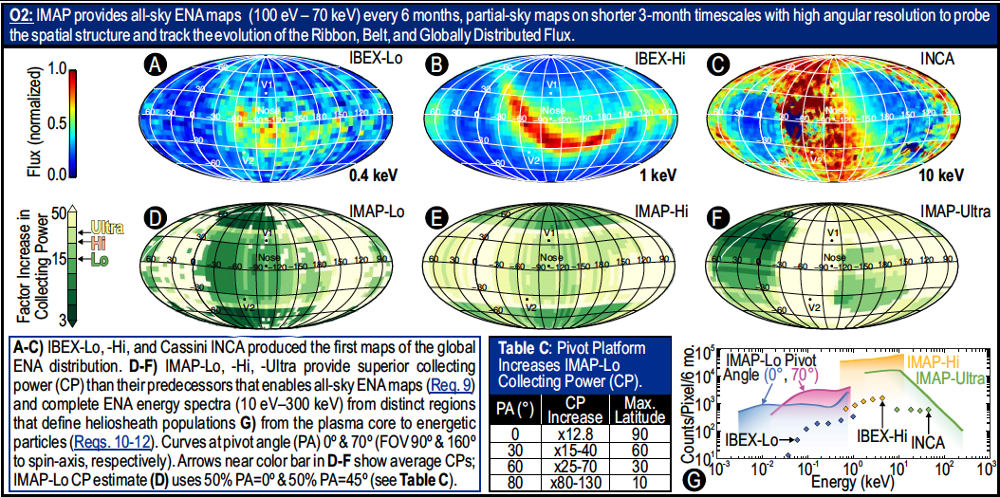
Revolutionary ENA Observations

Slide 8
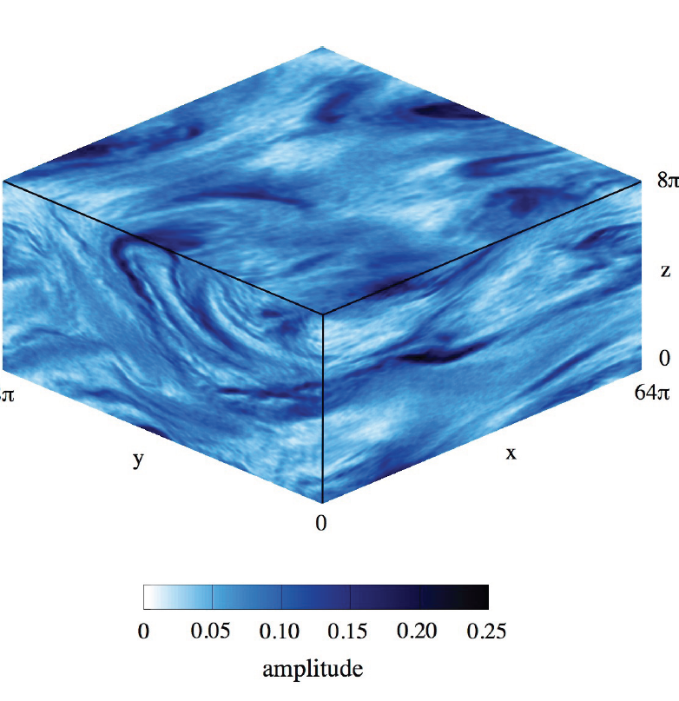
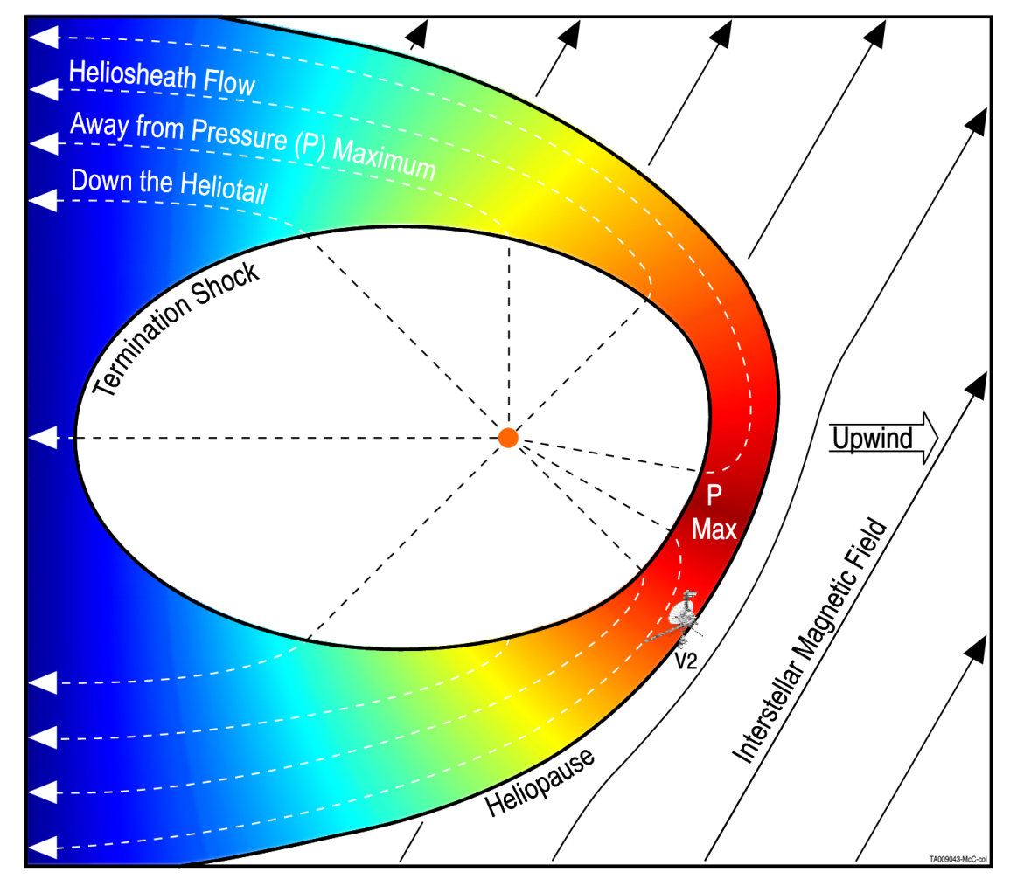
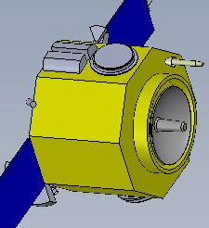
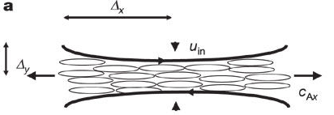
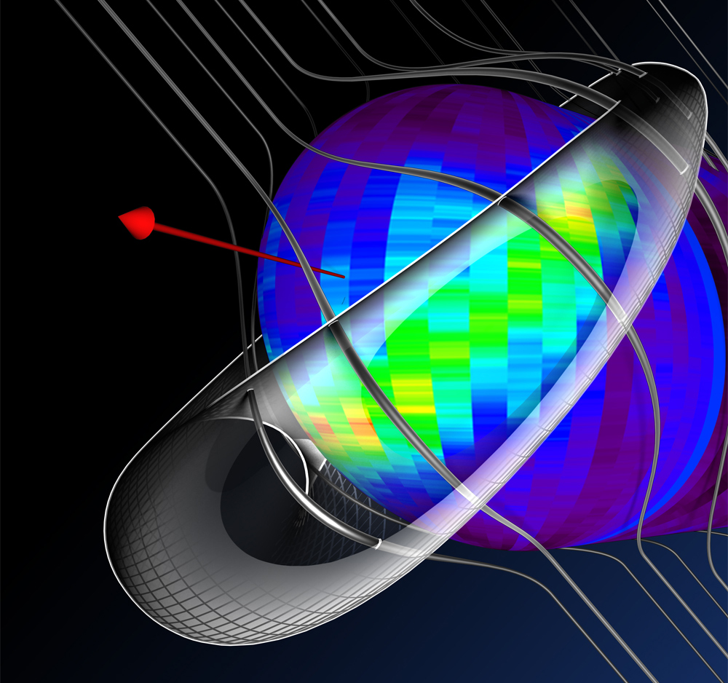
IMAP: connecting suprathermal physical processes with the Interstellar Interaction
McComas et al., 2012
McComas & Schwadron, 2014
Drake et al., 2012
Understand physics of resolved (~1 min) suprathermal processes from in situ data at 1 AU
IMAP
Schwadron and McComas, 2013
Gloeckler et al., 2012
Physics of the interstellar interaction, Ribbon, Belt and local interstellar medium

Slide 9
I-ALiRT Enhancement
Continuation of ACE data but with significantly higher cadence
New real-time observations
  Electron fluxes from large solar events arrive well before the damaging protons and ions → new prediction capability
  SW C6+/C5+, O7+/O6+, Mg/O, Fe/O, and Fe charge-state ratios along with SW moments enable identifying type of SW structure

Slide 10
Heliophysics Community Engagement
IMAP team draws widely across Heliophysics (25 institutions)
Welcome broad community into IMAP Science (IBEX SWTs → IMAP)
Set aside $2M from our cost cap for NASA-selected Guest Investigators in science phase who participate as full IMAP team members
Innovative Heliophysics Future Leaders (HFL) program:
  Address lack of diversity in Heliophysics instrument/mission leadership
  IMAP science mentors pair with a set of diverse and high-achieving graduate students and postdocs throughout the IMAP mission
  Participants chosen from a highly qualified pool of students and early career scientists, especially those serving underrepresented groups

Slide 11
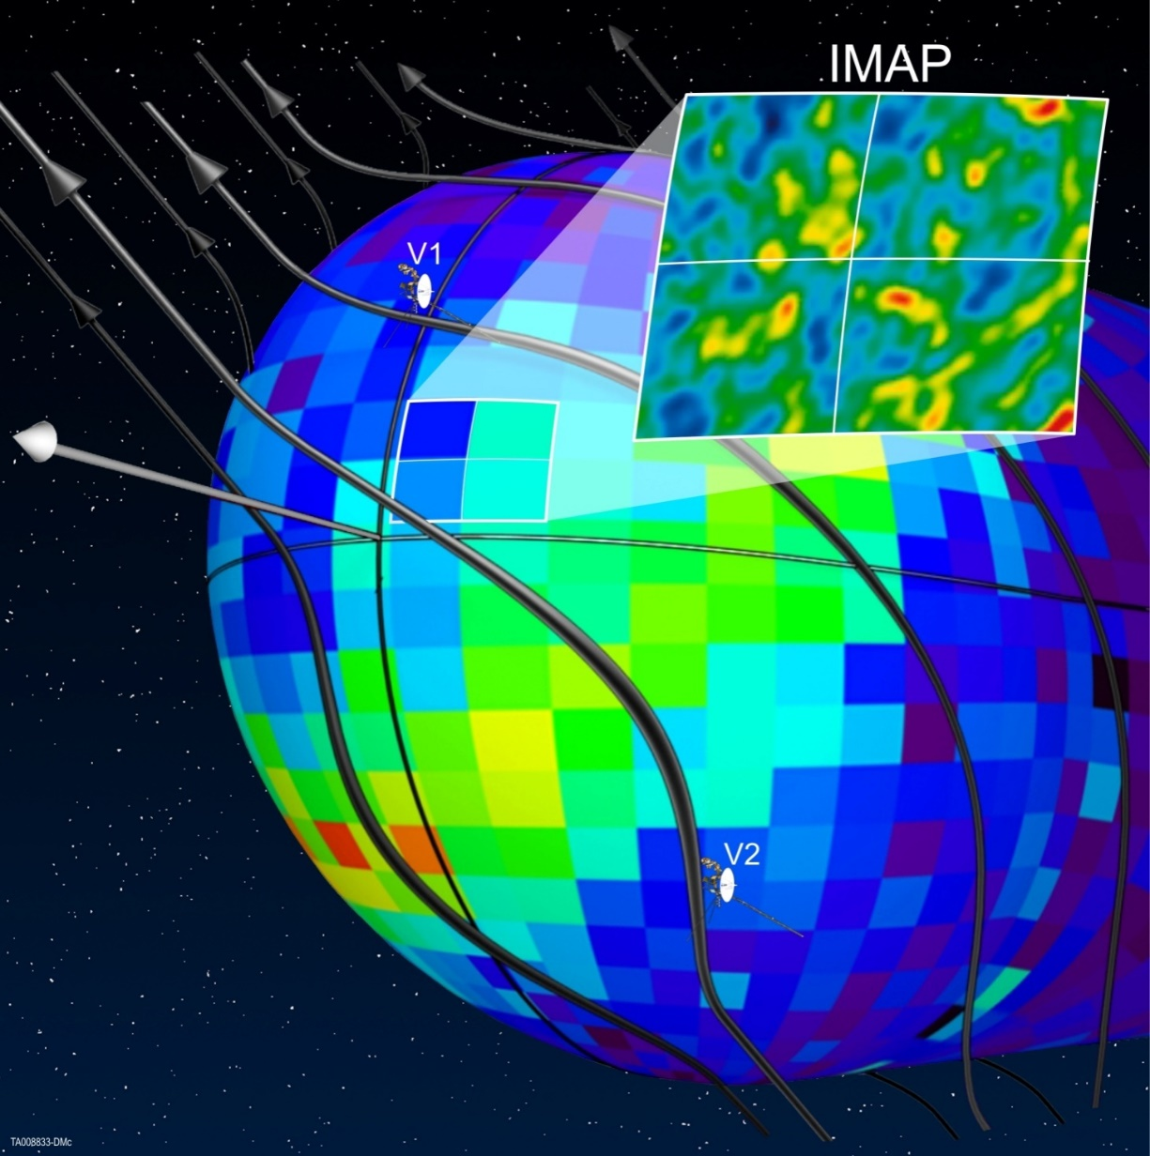

























Launching in 2024 – GO IMAP!!!
imap.princeton.edu

Slide 12

Space Science Reviews (open access)

Slide 13
Backup

Slide 15
Origin of Suprathermal Ions
ST tail continuously present
ST tail comprises material from many sources that vary in time & space
G. Gloeckler, et al., Proceedings of the 10th Annual International Astrophysics Conference 2012
What are the major constituents of the ST tail, how are they accelerated, how do they vary in time and space, and how do they affect shock acceleration of high-energy SEPs?

Slide 16
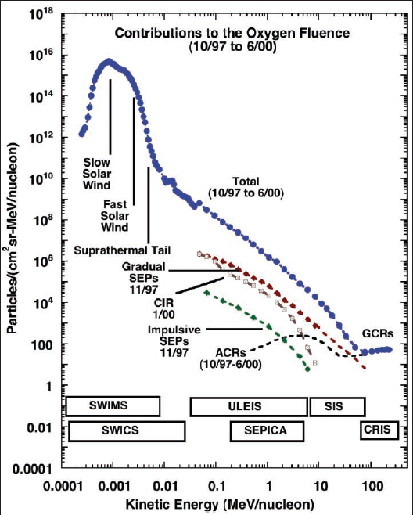
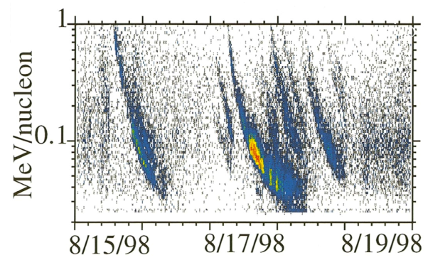
Suprathermal Particles
Mason G M, et al., 1999 3He Enhancements in Large Solar Energetic Particle Events ApJ 525 L133 doi:10.1086/312349
Time variability at 1 AU critical
Suprathermal particles injected at the Sun and in interplanetary shock events stay relatively close to their field lines, providing seed populations that vary by orders of magnitude in space and time
Mewaldt, R.A.; et al. (2001). "Long-term fluences of energetic particles in the heliosphere". AIP Conf. Proc. 86: 165.

Slide 17
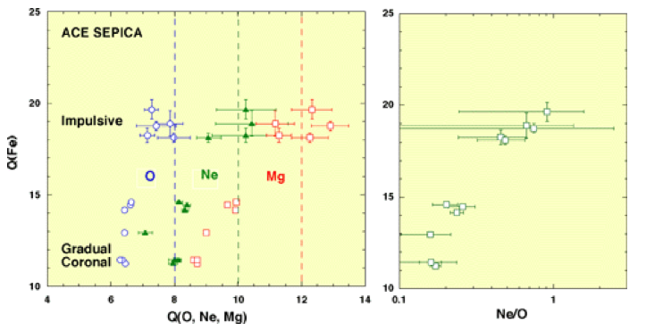
Ionic Charge States
Increase from low values in large shock-associated SEPs to high values in the 3He-rich SEPs – clues about origin and acceleration
But Ne/O also increases with Fe Q-states --- Difficult to reconcile with M/Q- dependent processes since Ne is fully stripped?

Slide 18
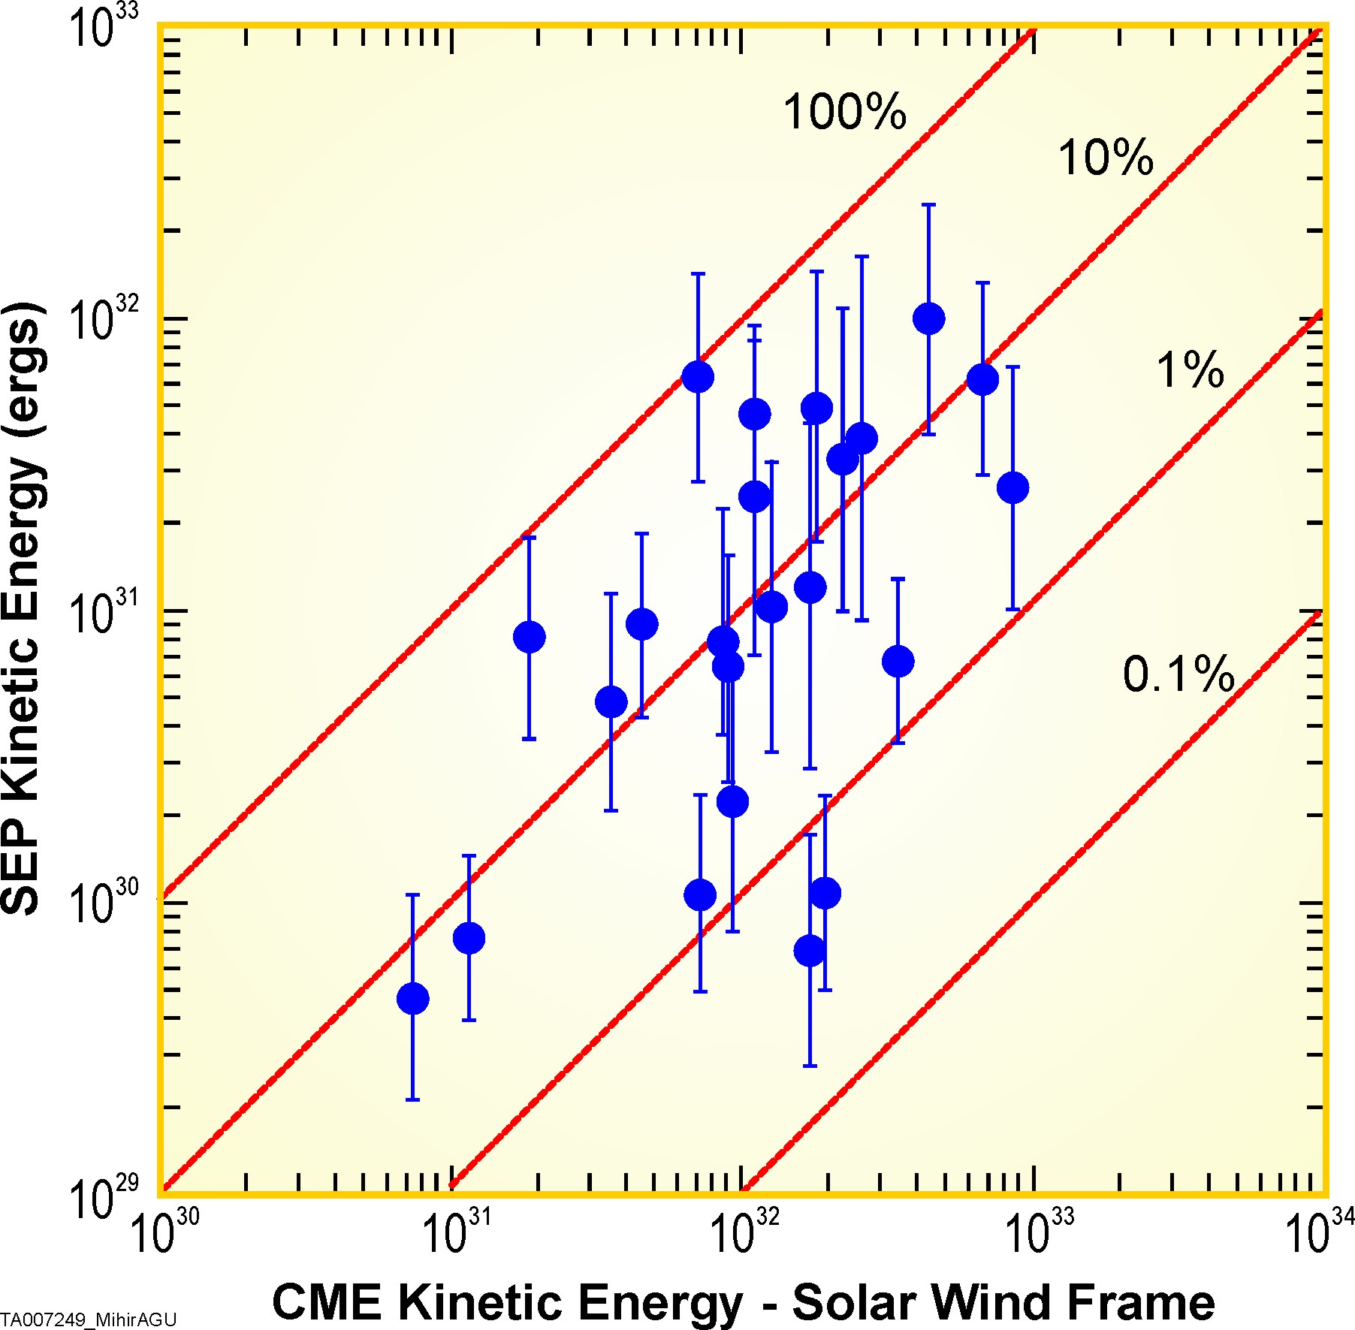
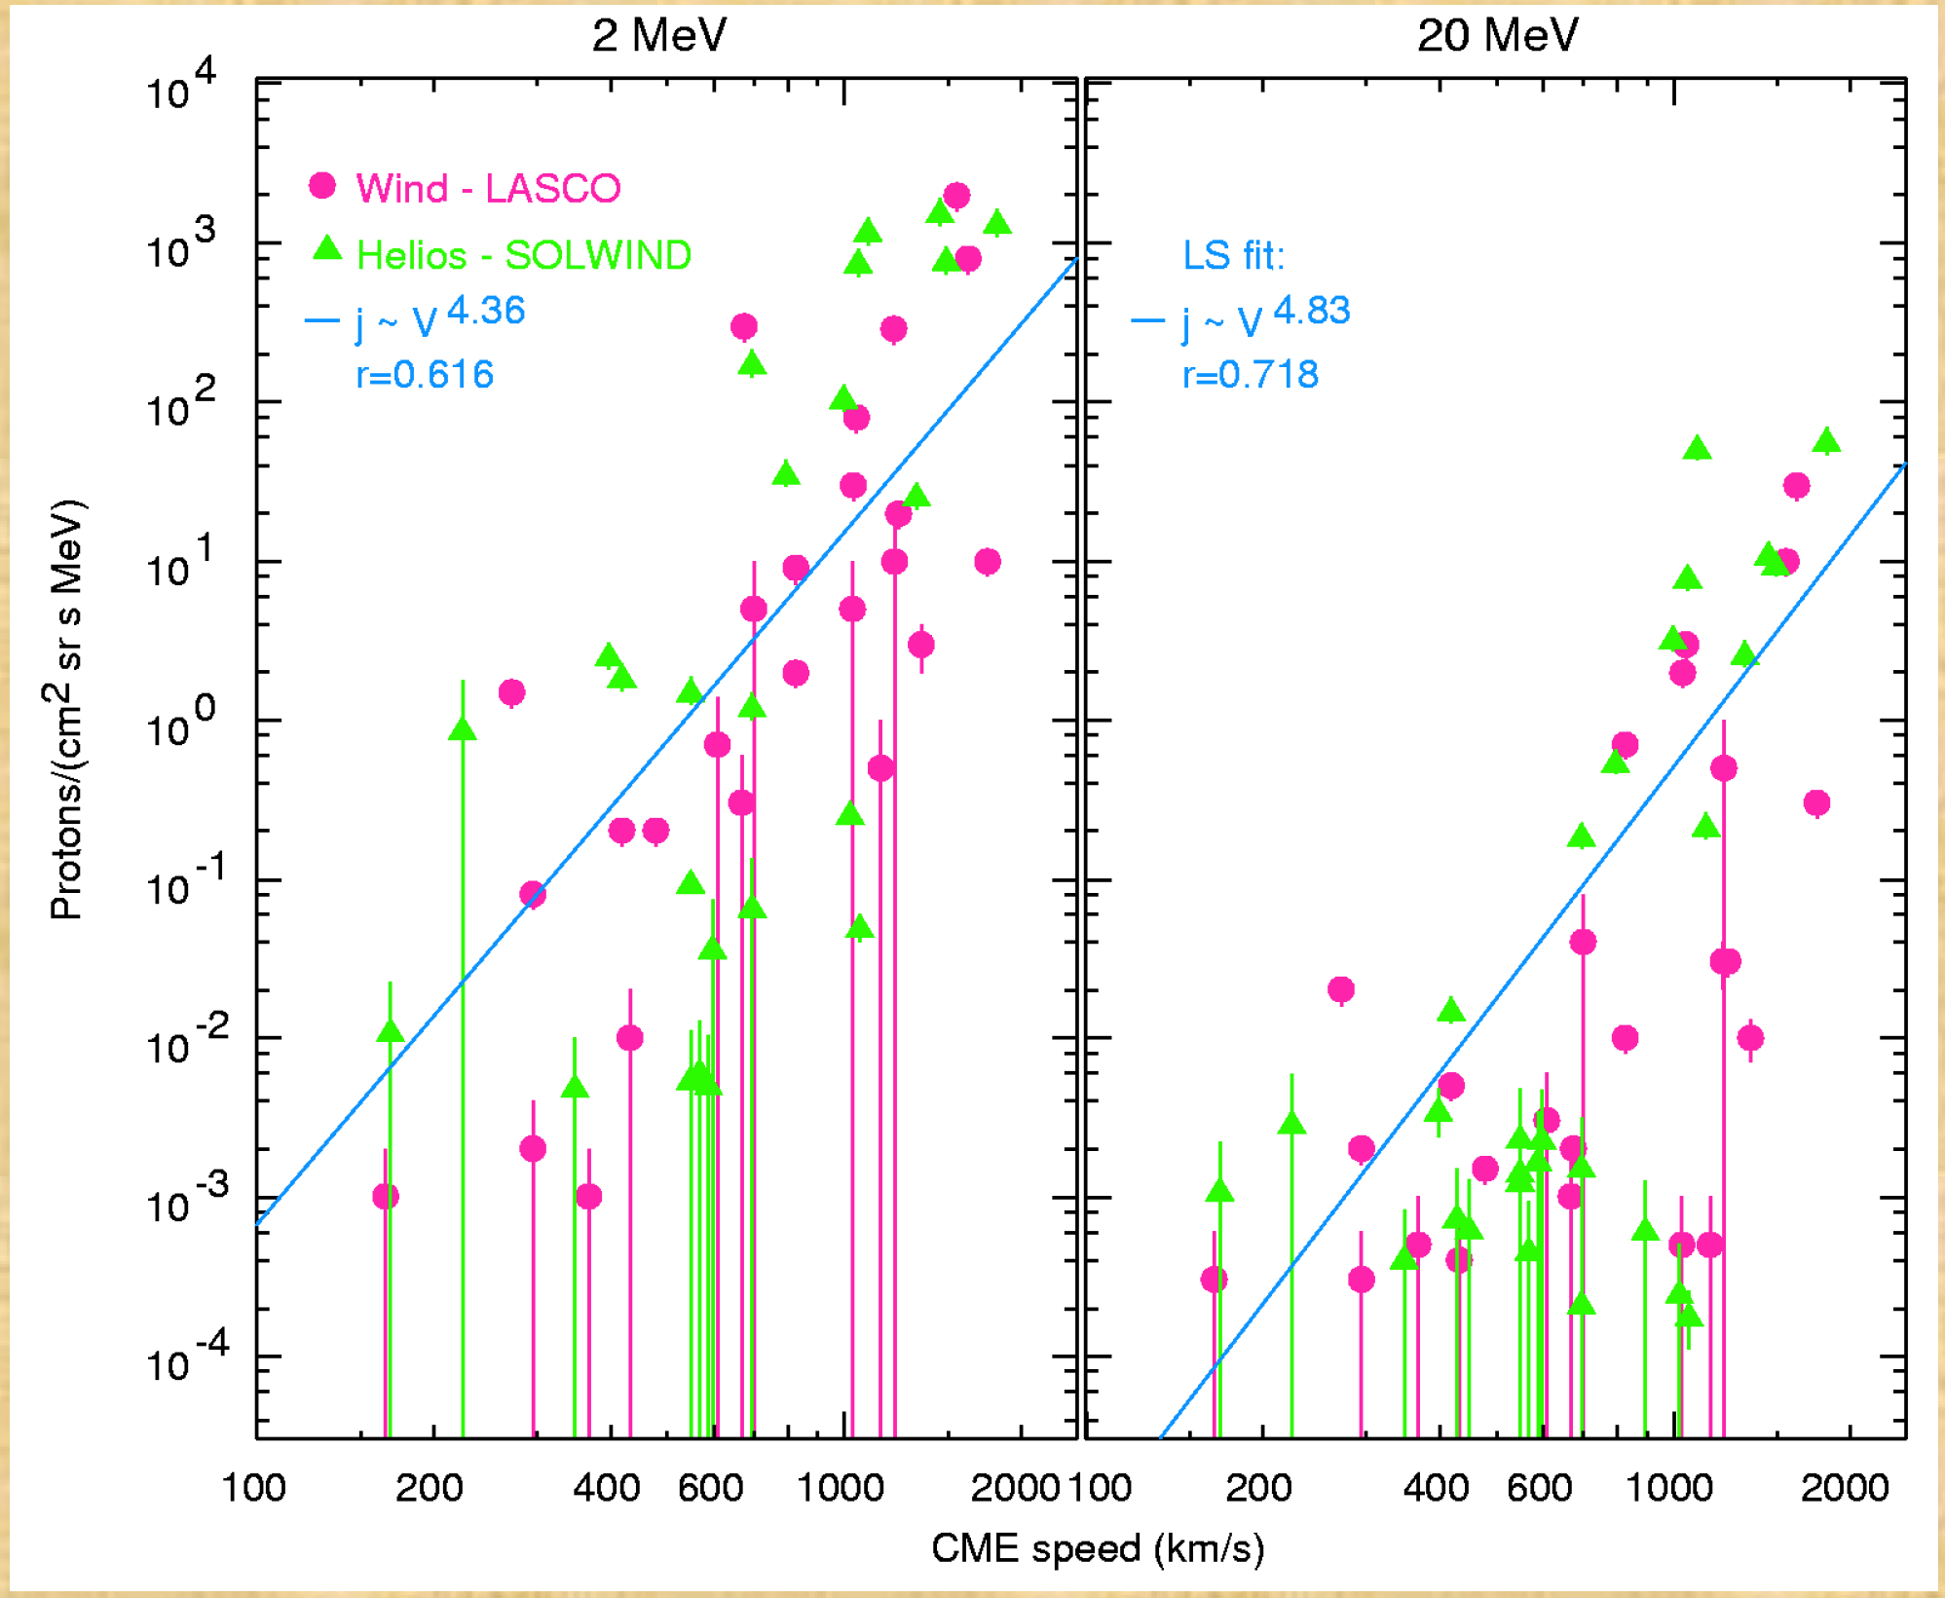
SEP Acceleration
Mewaldt et al., (2006)
Kahler (2001)
~10% of CME energy is spent in accelerating SEPs
CME speed (km/s)
Particle intensities correlate with CME speed
What causes variations in acceleration efficiency & in SEP intensities?

Slide 19
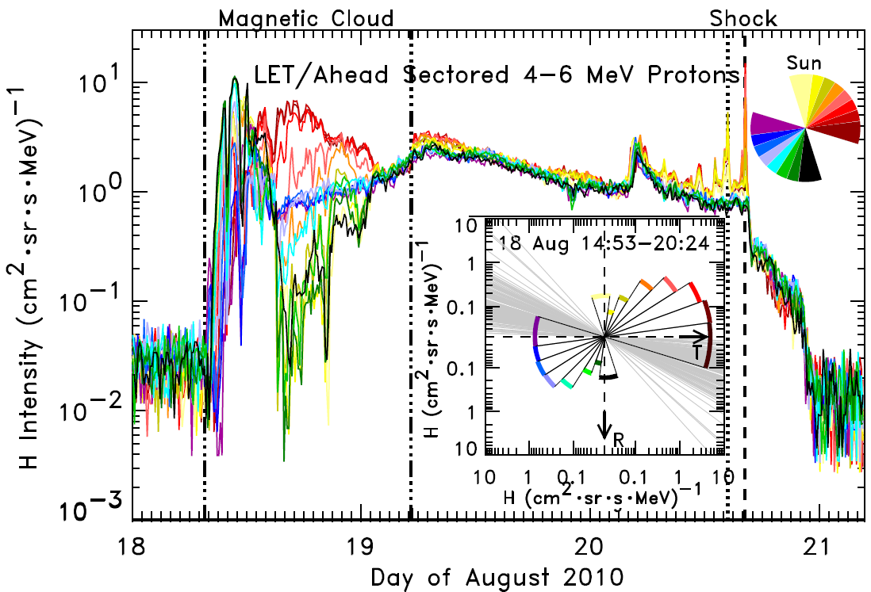
Transport and Anisotropies
Leske et al., Solar Physics, 2012, doi:10.1007/s11207-012-0018-5

Slide 20
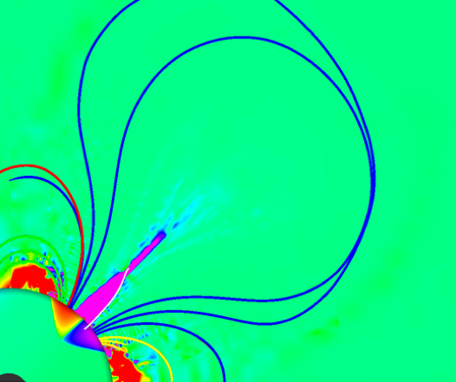
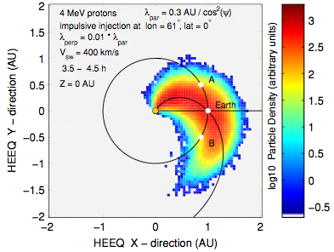
Theory and Modeling
CME liftoff
Advanced theory and modeling are critical for interpretation and handling of sparse data sampling
Dröge et al (2010)

Slide 21
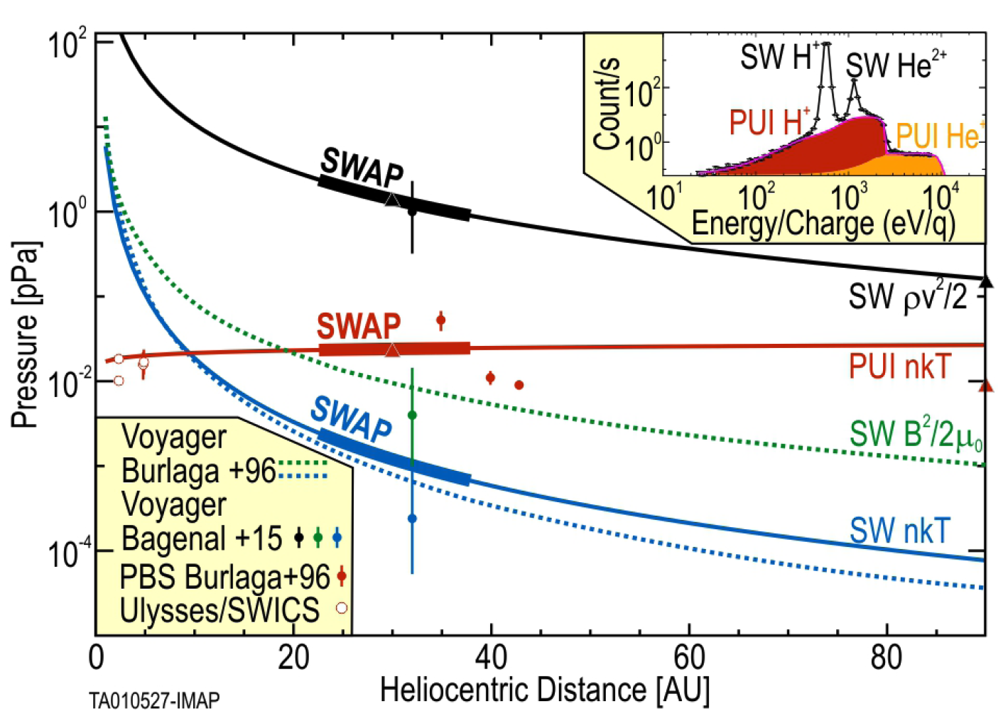
IMAP connects the dots: 1 AU – Outer Heliosphere - LISM
McComas et al., ApJ, 2017

