Slide 1
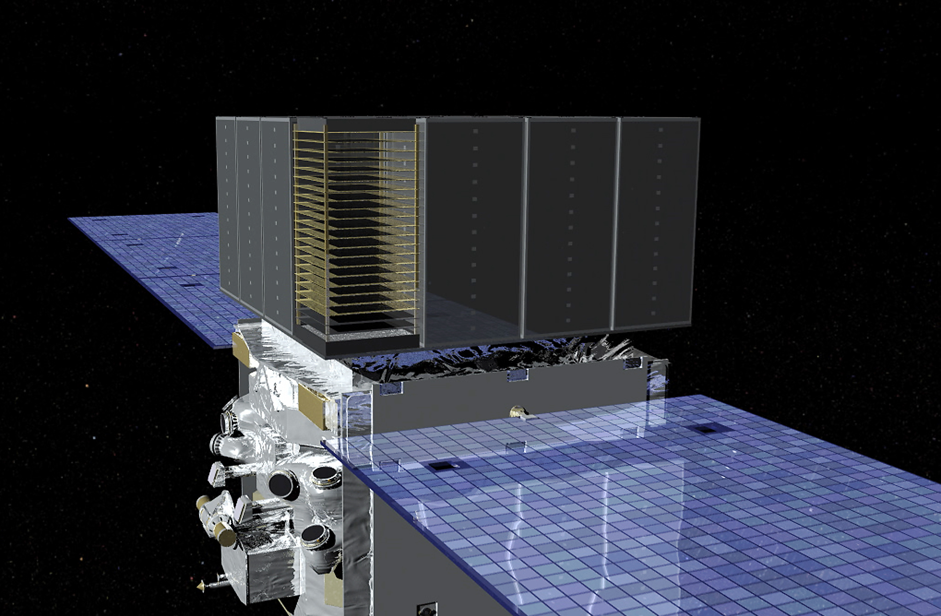
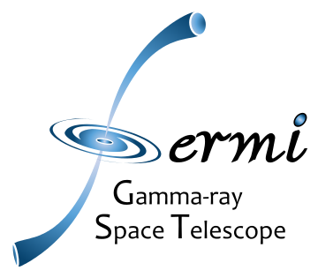
An All-sky Search for Cosmic- ray Proton Anisotropy with the Fermi Large Area Telescope
Justin Vandenbroucke and Matthew Meehan (University of Wisconsin)
for the Fermi Large Area Telescope Collaboration
July 26, 2019
ICRC 2019, Madison, WI

Slide 2
Motivation
Cosmic-ray anisotropy has been measured from TeV to EeV scale by ground-based experiments
Most of these experiments make 1D measurements in right ascension (insensitive to declination)
Ground-based experiments also have limited composition resolution
Fermi LAT has recorded the largest ever set of cosmic-ray protons at the 100 GeV scale, with excellent composition, direction, and energy resolution
179 million events above 78 GeV
Fermi LAT is sensitive to full sky without any holes and with full 2D sensitivity and excellent particle identification: capable of probing proton anisotropy with arbitrary orientation including declination components
Full description of analysis and results at arXiv:1903.02905
Notes:
8 years: December 26, 2008 – December 26, 2016

Slide 3
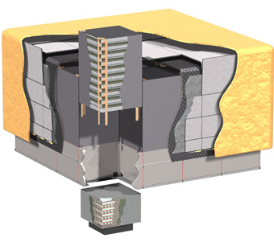
The Fermi Large Area Telescope (LAT)
Tracker: tungsten conversion foils + silicon strip detectors, 1.5 radiation lengths on-axis
Calorimeter: 1536 Cesium Iodide crystals, 8.6 radiation lengths on-axis, gives 3D energy deposition distribution
Anti-Coincidence Detector: charged particle veto surrounding Tracker, 89 plastic scintillator tiles + 8 ribbons
~1.8 m
γ
Tracker
A space-based detector complementary to ground-based instruments
Views 4π sky
Direct identification of primary particles
Low energy threshold
Small effective area compared to ground-based detectors
ACD
e⁻
e⁺
Calorimeter
Atwood et al., ApJ 697, 1071 (2009)
Notes:
ACD ribbons are scintillator ribbons to cover gaps in tile coverage
26° orbit inclination
Dimensions and layout of CAL and ACD segments?
ACD: 0.9997 efficiency for tagging singly charged particles; 0.06 radiation lengths
On axis total: 10.1 radiation lengths
Tracker: 16 modules: tungsten conversion foils + 80 m² of silicon strip detectors in 36 layers, 1.5 radiation lengths on-axis (73 cm^2 of active silicon)
Calorimeter: 16 modules: 96 Cesium Iodide crystals per module, 8.6 radiation lengths on-axis, gives 3D energy deposition distribution
Anti-Coincidence Detector: charged particle veto surrounding Tracker, 89 plastic scintillator tiles + 8 ribbons,

Slide 4
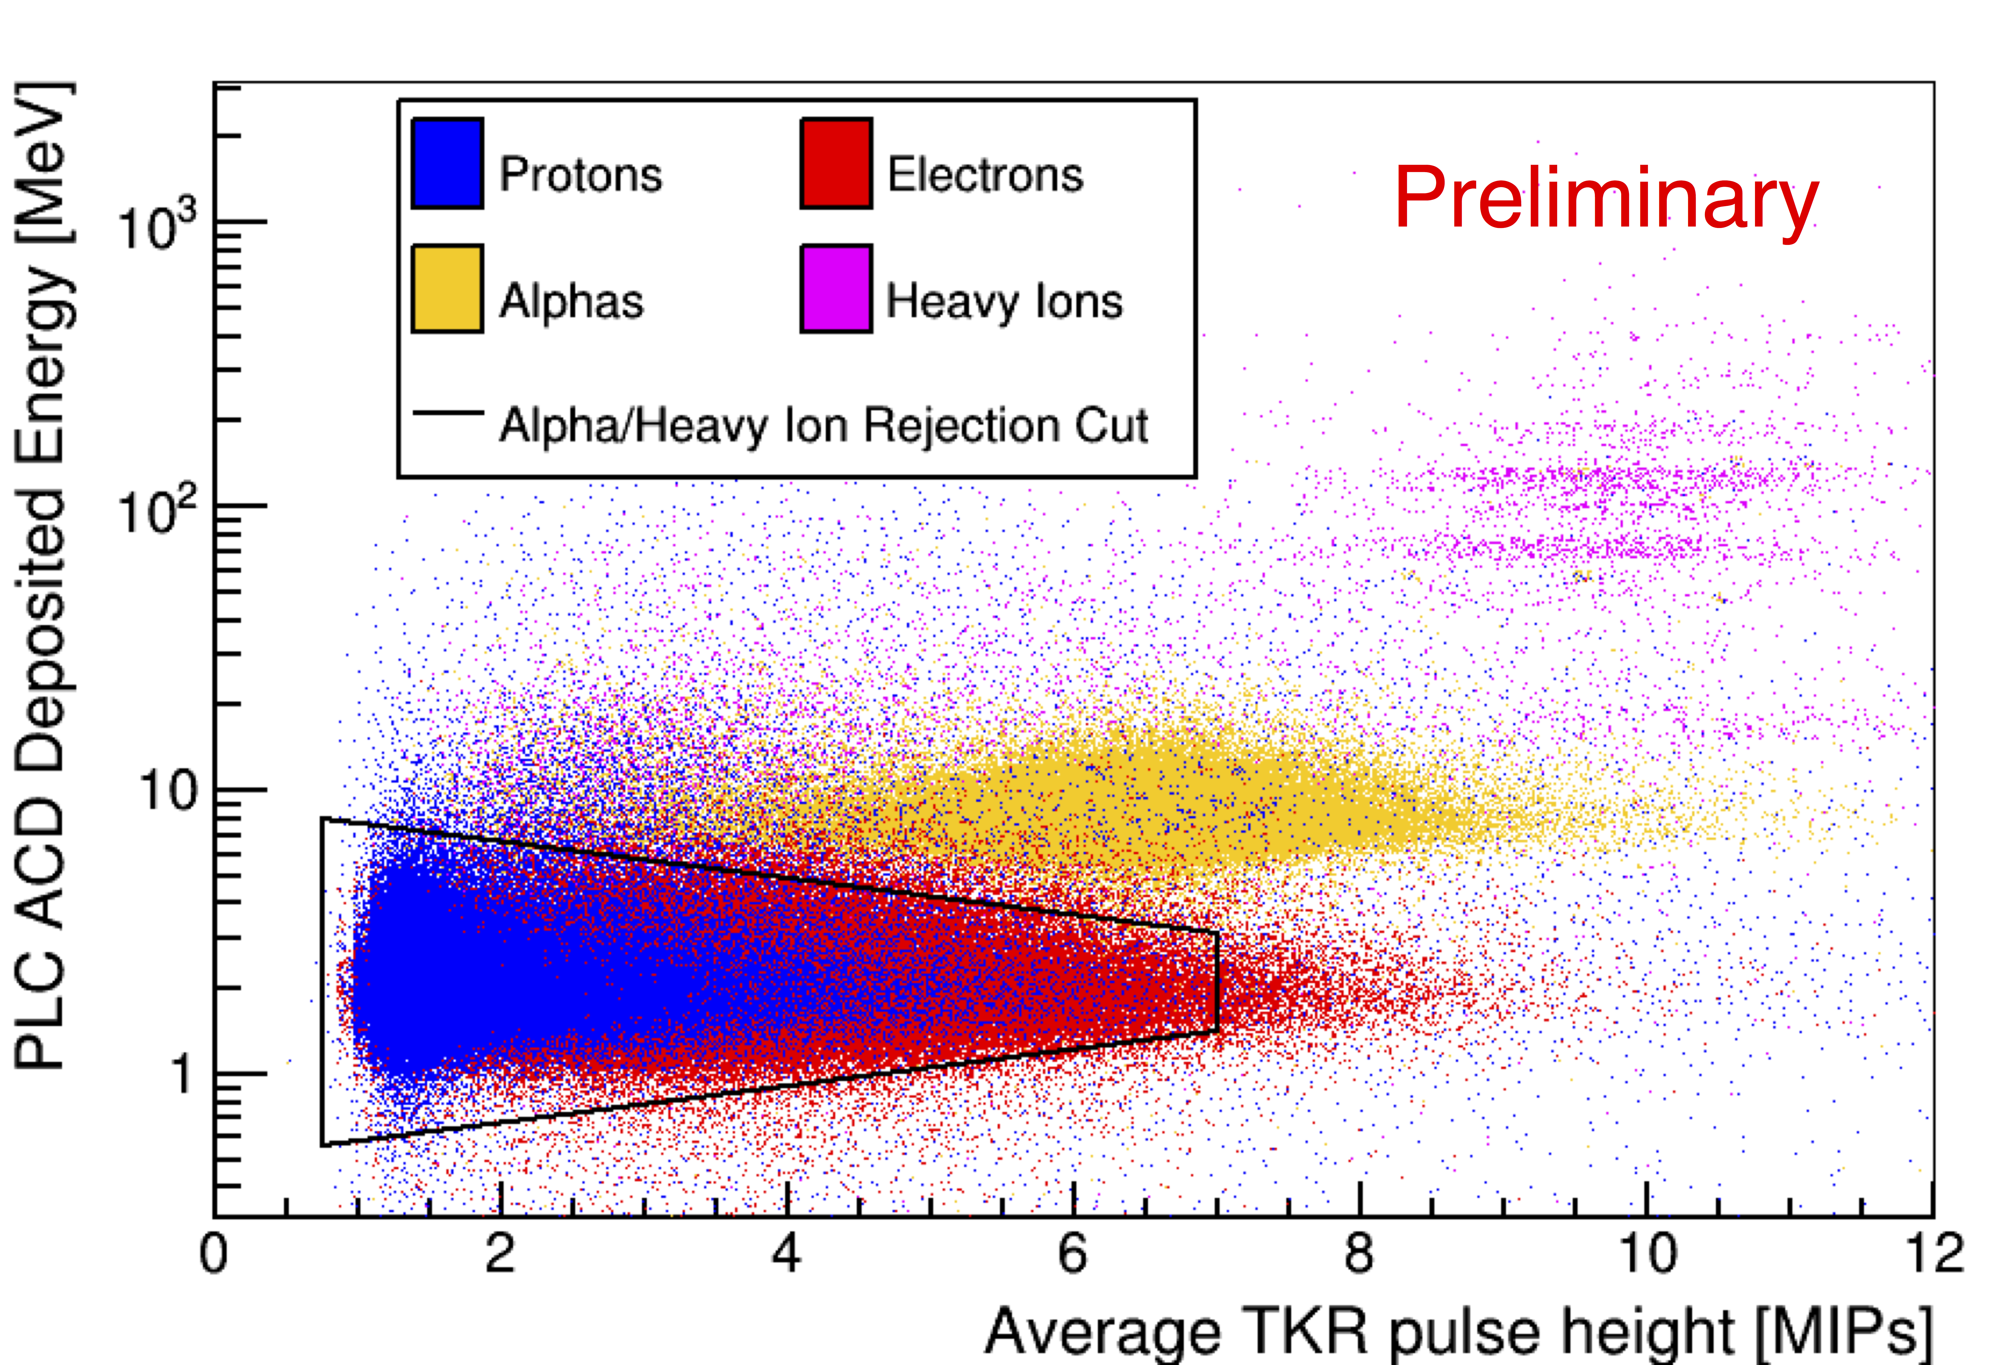
Particle identification
Unlike ground-based detectors, the LAT can cleanly separate protons, helium, heavy ions, electrons
Notes:
Three horizontal bands are CNO
H, He, B, Be, Li ,C, N, O

Slide 5
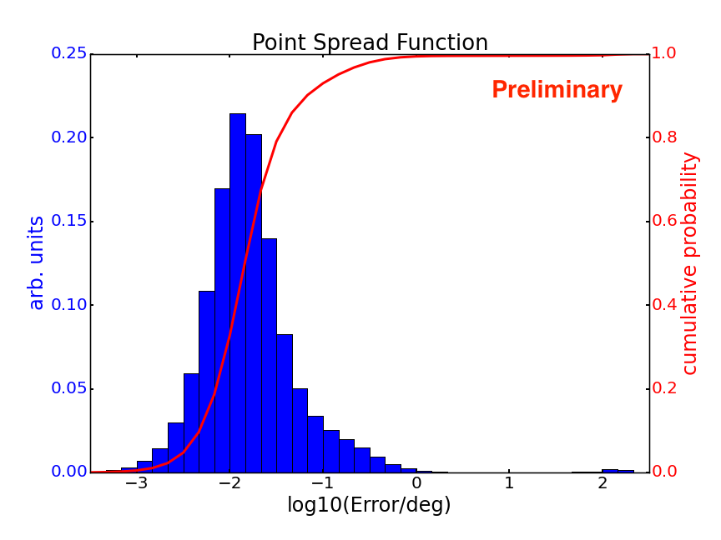
Proton angular resolution
Median angular error is ~0.01°
More than 90% of events are <0.1°

Slide 6
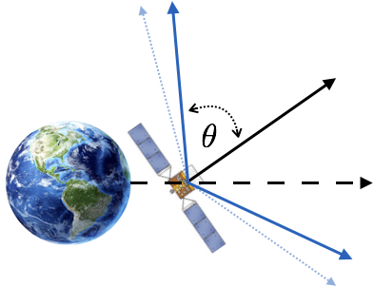
Removing geomagnetic effects by removing events far off instrument axis
𝜃 < 60°
𝜃 < 45°
arXiv:1903.02905
altitude-azimuth coordinates
(based on instantaneous spacecraft coordinates)
Example for lowest energy bin (78-139 GeV)
Tighter cut removes more events near horizon (with large geomagnetic deflection)
We use 𝜃 < 45°below 139 GeV and
𝜃 < 50°above 139 GeV
Notes:
July 2019: figures taken from journal paper overleaf
Figure 7. Sky maps in altitude-azimuth coordinates for events with a maximum off-axis angle cut of 45° (top) and 60° (bottom). Altitude is the complement of the zenith angle and the azimuth is measured from N=0° and increases towards the E. The “east-west” effect is clearly visible in the data when a larger field of view is allowed.

Slide 7
Data-driven reference map algorithm
In each energy bin and one-year time bin:
Determine average number of events N in each second of livetime
Histogram events in detector (theta, phi) coordinates
From N, choose Poisson count for each second of livetime
Choose direction of each event from (theta, phi) distribution
Calculate sky direction from spacecraft pointing
Build sky map
Average 100 realizations to beat down statistical noise

Slide 8
8 year reference map compared to data map: which is which?
Data Reference
arXiv:1903.02905
equatorial coordinates
Notes:
Pixel side length: Nside=16, so 3072 pixels on the sky each 13.4 sq deg
Side length: sqrt(4*pi*180/pi*180/pi/3072) =3.7°
July 2019: figures plus numbers above taken from journal paper overleaf
Figure 2. Data and reference sky maps in equatorial coordinates (J2000) for all events in the data set. Sky maps are created using the HEALPix pixelization scheme with 3072 pixels and use the astronomical convention of right ascension increasing to the left.

Slide 9
8 year relative intensity and significance
equatorial coordinates
arXiv:1903.02905
(data - reference) / reference
Li-Ma significance
All events (E_{reco} > 78 GeV)
Notes:
3072 pixels on the sky, each ~13 sq deg
July 2019: figures taken from journal paper overleaf (Fig 3)
Figure 3. Relative intensity and significance maps in equatorial coordinates (J2000) for all events in the data set. Statistical fluctuations are smaller towards the equatorial poles because the exposure is greater towards the poles. Sky maps are created using the HEALPix pixelization scheme with 3072 pixels and use the astronomical convention of right ascension increasing to the left.

Slide 10
Single-pixel significance distribution
arXiv:1903.02905
Notes:
July 2019: figures taken from journal paper overleaf (Fig 7)
Todo: calculate p value for this dof and chi-squared

Slide 11
8 year angular power spectrum
arXiv:1903.02905
cumulative (E_{reco} > 78 GeV)
C_{N} (noise power expected due to finite statistics) subtracted
Excess power found in dipole (p = 0.01)
Notes:
July 2019: figures taken from journal paper overleaf
Figure 5. Angular power spectrum calculated for the relative intensity map with a minimum energy of 78 GeV. The horizontal axis is the multipole l of the spherical harmonic expansion and the vertical axis is angular power at that l value. The angular scale of each multipole is ∼180°/l. C_{l} is the angular power in the map, which includes an anisotropic component and a noise component, C_{N}. The angular power due to white noise is subtracted from the measured power, which is the maximum likelihood estimator for the underlying anisotropy in the map. The error bars are the statistical uncertainty on the measured angular power. The colored bands represent the distribution of expected results under the null hypothesis, i.e., isotropic sky.

Slide 12
Dipole amplitude vs. energy
arXiv:1903.02905
Bands give range of expected dipole amplitude due to statistical noise under null hypothesis (isotropic sky)
Data points generally consistent with null hypothesis
Notes:
July 2019: figures taken from journal paper overleaf
Figure 6. Top: Measured dipole amplitude, δ, for each cumulative energy bin. The dipole amplitude is calculated directly from the measured dipole power (C₁). The error bars are the statistical uncertainty on the measured quantities and the colored bands represent the distribution of expected results under the null hypothesis, i.e., isotropic sky.

Slide 13
Dipole amplitude upper limits vs. energy
arXiv:1903.02905
Notes:
July 2019: figures taken from journal paper overleaf
Figure 6. Bottom: 95% confidence level upper limits on the dipole amplitude for each cumulative energy bin. The dashed line represents the expected upper limits under the null hypothesis. The colored bands show the 68% and 95% containment of upper limits expected from an ensemble of measurements under the null hypothesis.

Slide 14
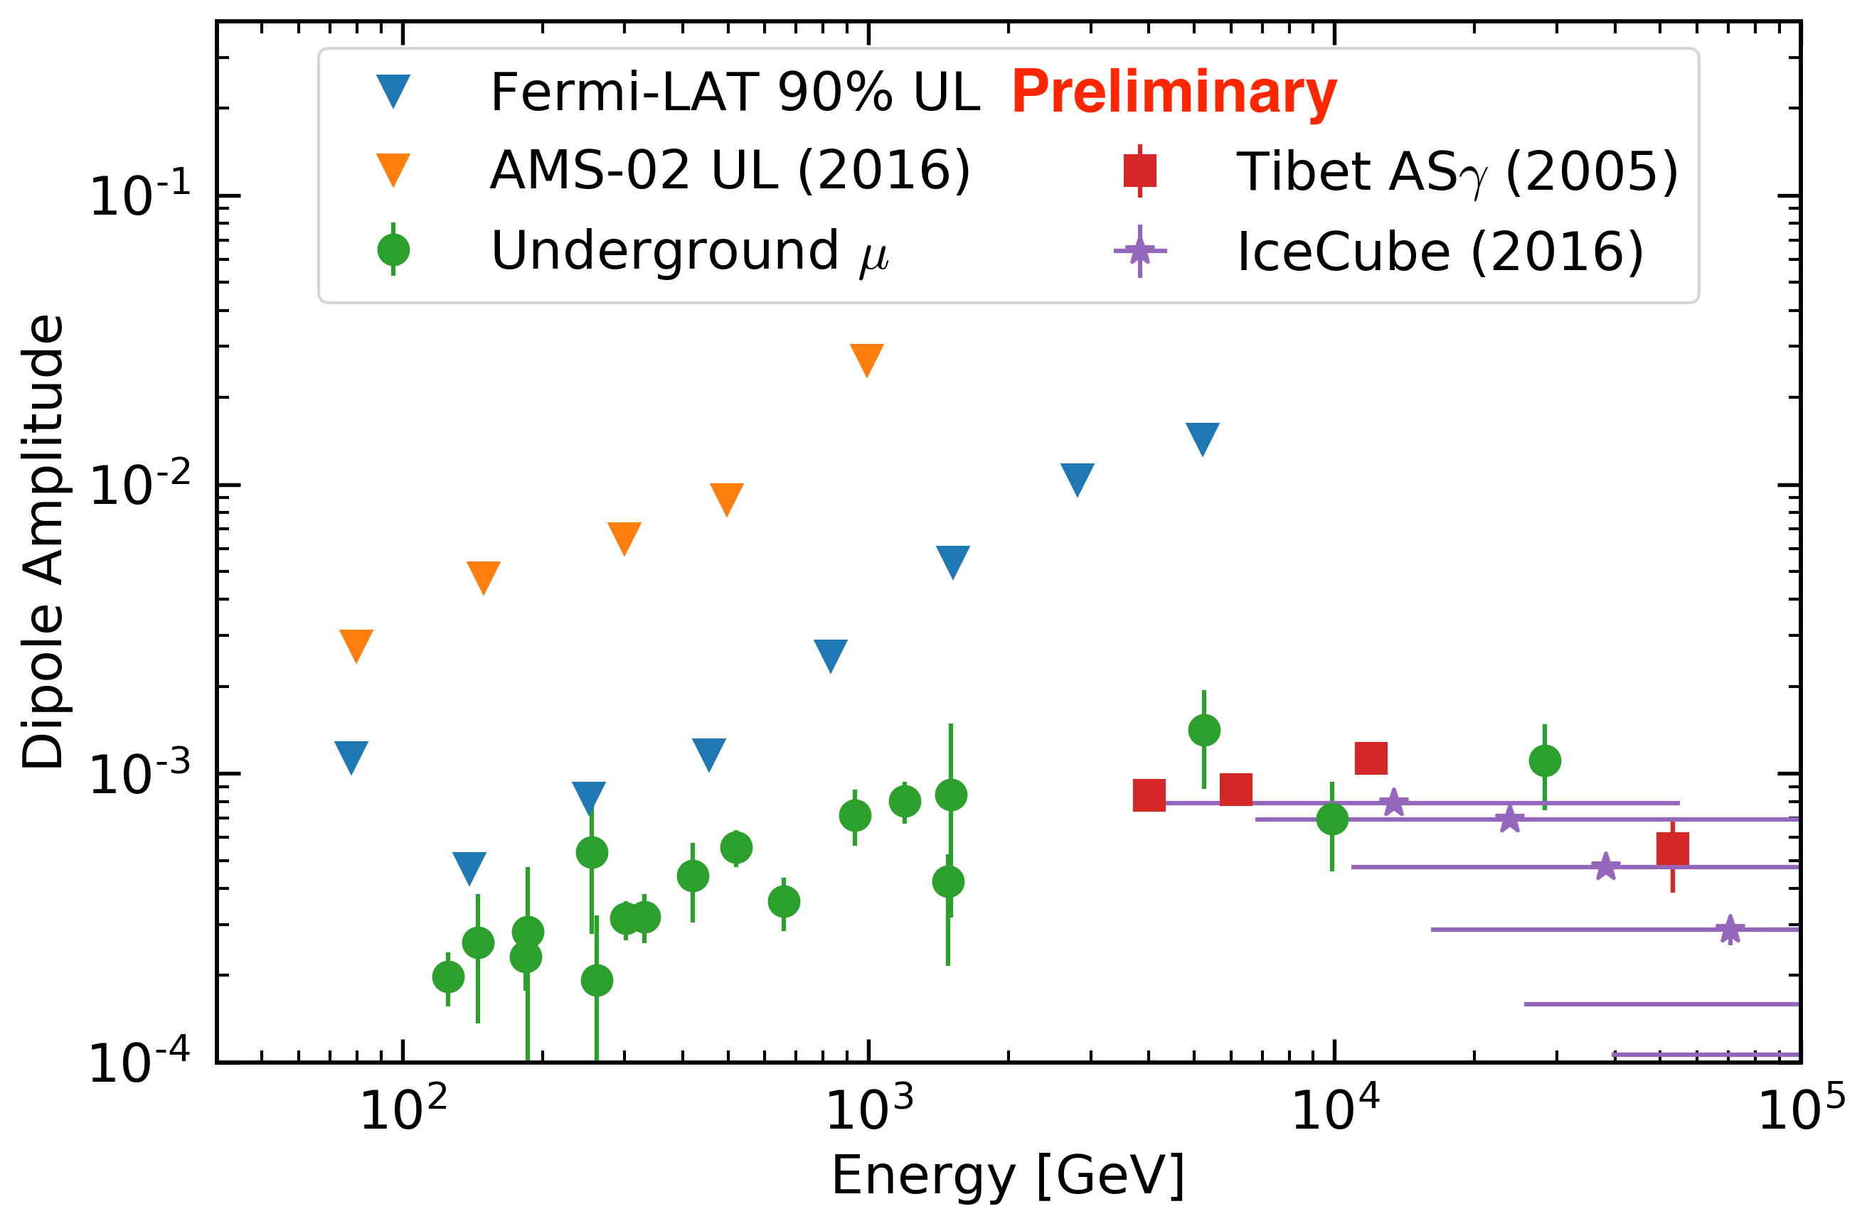
LAT dipole results in context
Note: Fermi LAT and AMS upper limits are cumulative

Slide 15
Conclusion
179 million well-reconstructed proton events recorded in 8 years of LAT data provide full-sky and all-orientation anisotropy sensitivity
For all events above 78 GeV, dipole power with modest statistical significance (p = 0.01)
  Interpreted as signal: amplitude (3.9 ± 1.5) x 10⁻⁴
  Alternatively, set amplitude upper limit (95% CL): 1.3 x 10⁻³
Energy-resolved upper limits on dipole amplitude between 78 GeV and 10 TeV
Strongest full-sky, all-orientation constraints (including declination components) in any energy range
Strongest pure-proton constraints in any energy range
Full description of method and results: arXiv:1903.02905 and M. Meehan PhD thesis (University of Wisconsin, 2019)
Notes:
P = 0.01: significance 2.6 sigma
2.5: 0.0124
2.53: 0.0114
2.55: 0.0108
2.57: 0.0102
2.58: 0.00988
2.60: 0.00932

Slide 16
Additional slides

Slide 17
Quantitative details of dipole results
arXiv:1903.02905

Slide 18
Monte Carlo demonstration of reference map method
arXiv:1903.02905
Inject dipole at various angles relative to North Celestial Pole
Time-scrambling method underestimates true signal amplitude
Our rate-based method recovers the true signal amplitude
Notes:
July 2019: figures taken from journal paper overleaf:
Figure 1. Results from an MC study comparing two reference map methods using an ideal detector with a conical field of view with a maximum off-axis angle of 60°. Each realization consists of one million events injected with a 1% dipole oriented at an angle α relative to the North Celestial Pole. Reference maps were created using the time-scrambling method (top) and the rate-based method (bottom). The null hypothesis refers to realizations with events injected isotropically.

Slide 19
All three dipole orientations
(cumulative energy bins)
arXiv:1903.02905
Notes:
July 2019: figures taken from journal paper overleaf
Figure 4. Measured a_{1m} coefficients of the spherical harmonic expansion vs. minimum energy. From left to right: a₁₋₁, a₁₀, and a₁₁. Note that the a₁₀ coefficient corresponds to the dipole component aligned with the polar axis, which is unconstrained by ground-based measurements. The error bars are the 1σ statistical uncertainty on the measured coefficients and the colored bands represent the distribution of expected results under the null hypothesis, i.e., isotropic sky.

Slide 20
LAT dipole results in context
Other results in this energy range are from underground muon measurements (intensity vs. right ascension) in 1980s and 1990s
Notes:
July 2019: figures taken from journal paper overleaf (Fig 13)
Figure 13. Comparison of the amplitude (A₁) and phase (Φ1) of the one-dimensional, i.e., right ascension-projected, dipole term of the harmonic expansion measured by Fermi-LAT above 78 GeV compared to previous measurements by underground muon telescopes (Bercovitch & Agrawal 1981; Thambyahpillai 1983; Swinson & Nagashima 1985; Ueno et al. 1990; Mori et al. 1995; Munakata et al. 1995). The amplitude and phase were calculated from a1−1 and a11
coefficients of the spherical harmonic expansion using Equations 5 and 8 from Abeysekara et al. (2018a). The Fermi measurement is not significant, but is plotted here and upper limit from this work are both shown for completeness. The upper limit was calculated by projecting the 95\% C.L. upper limit on the total dipole amplitude onto the right ascension axis using the best fit direction from Table 2.

Slide 21
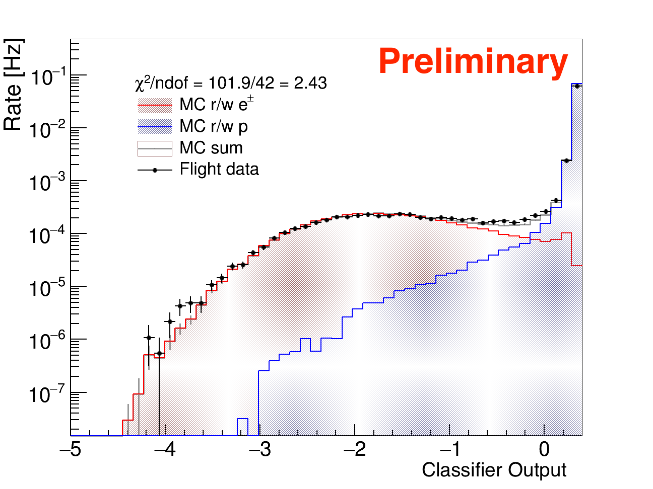
Hadron-lepton separation
example energy bin (455-830 GeV)
The LAT can cleanly separate protons and electrons
More details on classifier in Fermi LAT, PRD 95, 082007

Slide 22
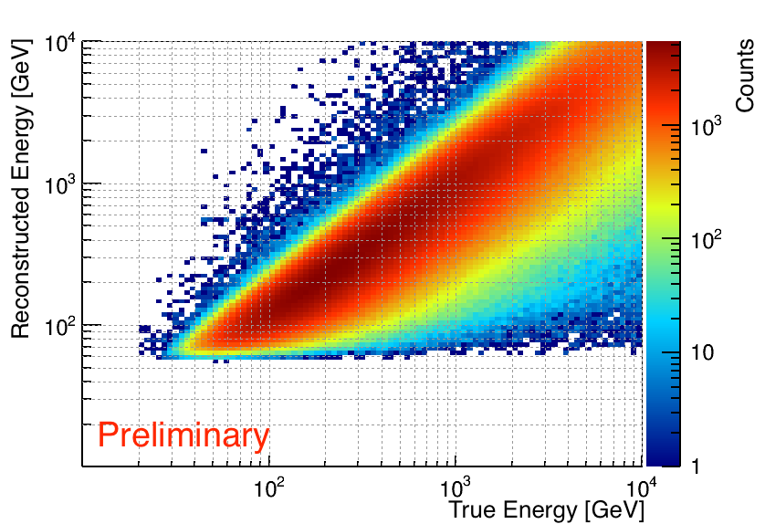
Proton energy resolution
Although hadronic showers are not contained, shower profile fit achieves good energy resolution

Slide 23
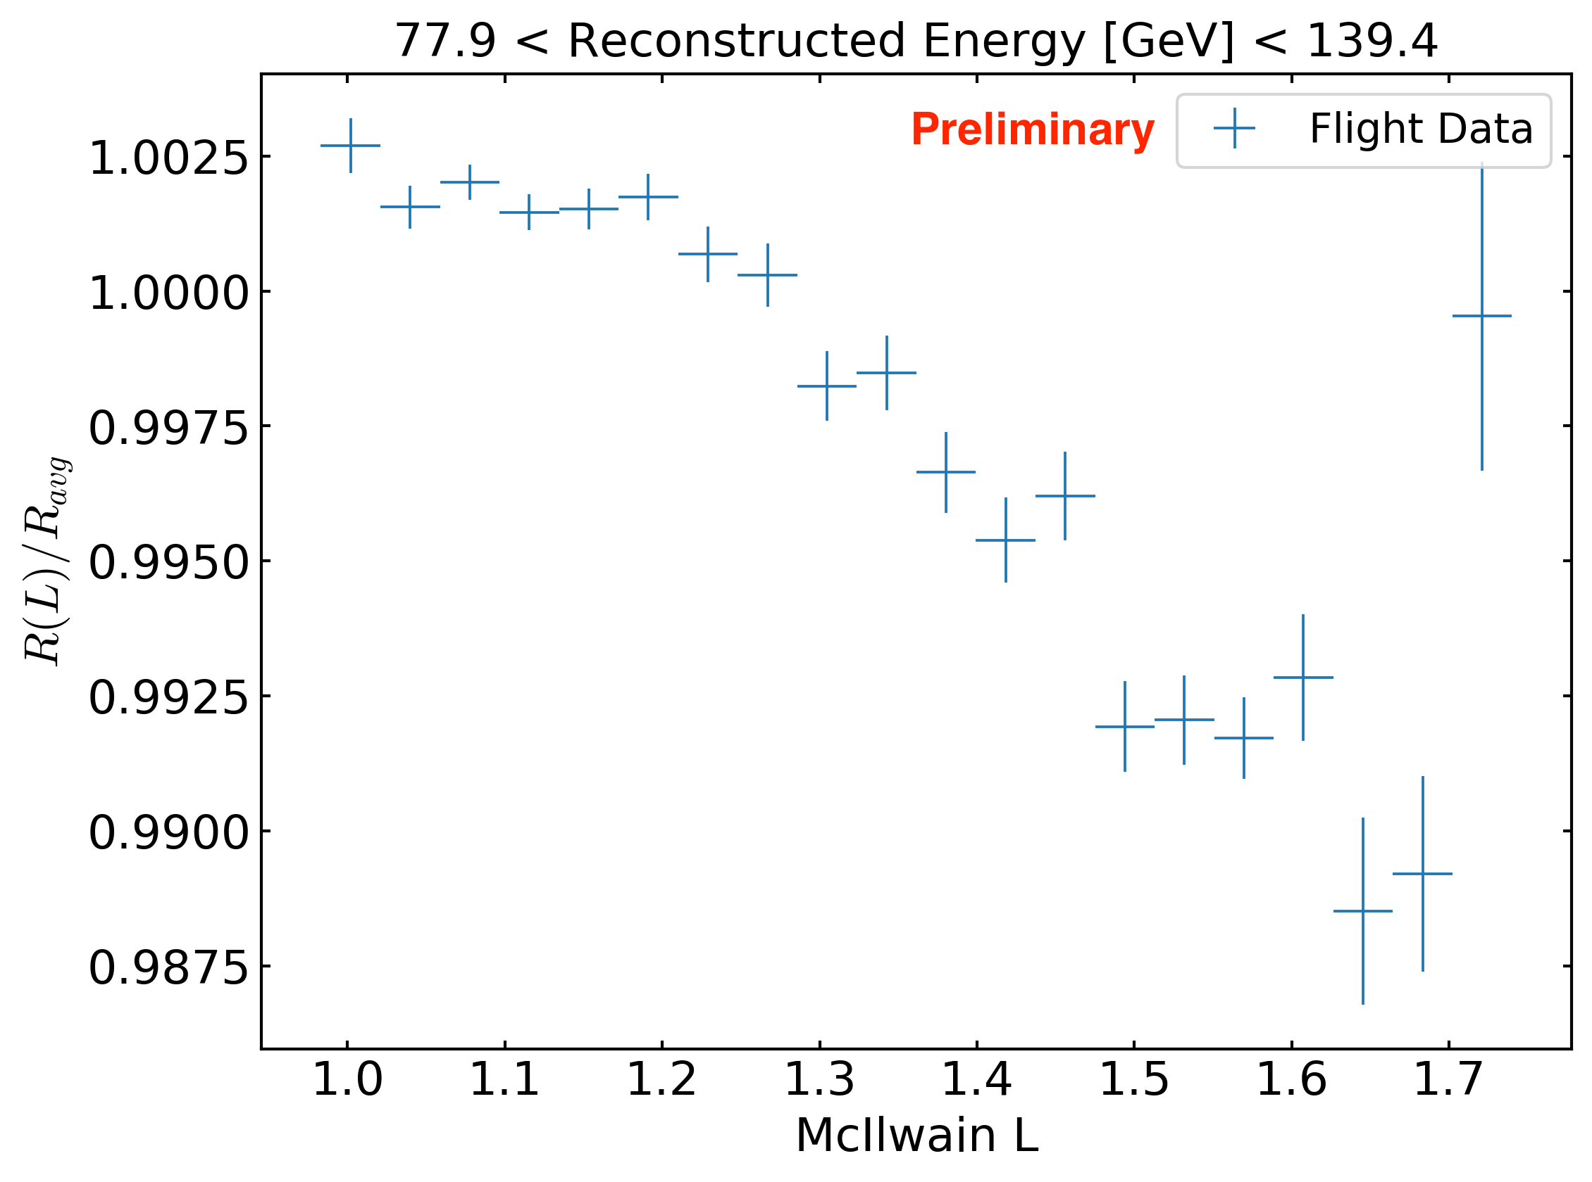
Systematic rate effect: 1% variation of event rate with local geomagnetic field
strong field
weak field
It is not a livetime effect (is present after livetime accounting)
Weaker field causes higher rate of low energy events: pileup/ghosts reduces rate of high quality events passing selection cuts
Original reference map algorithm assumed rate is constant (neglected this effect)
Can this explain excess dipole and quadrupole power?

Slide 24
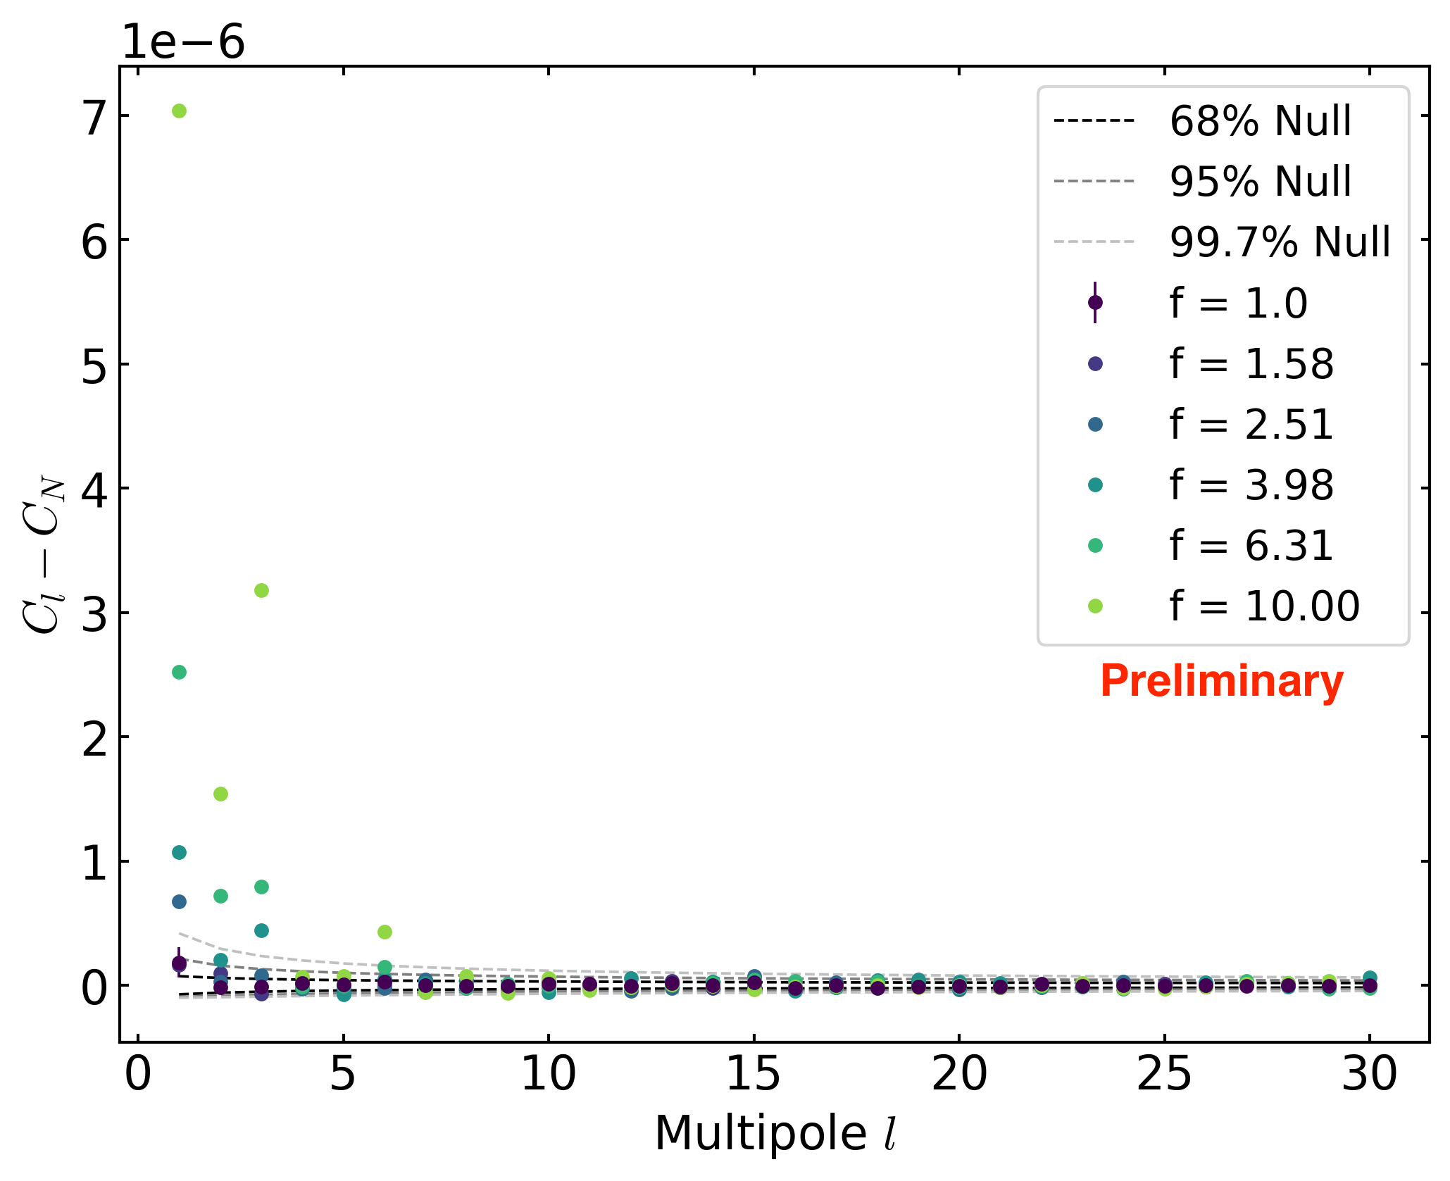
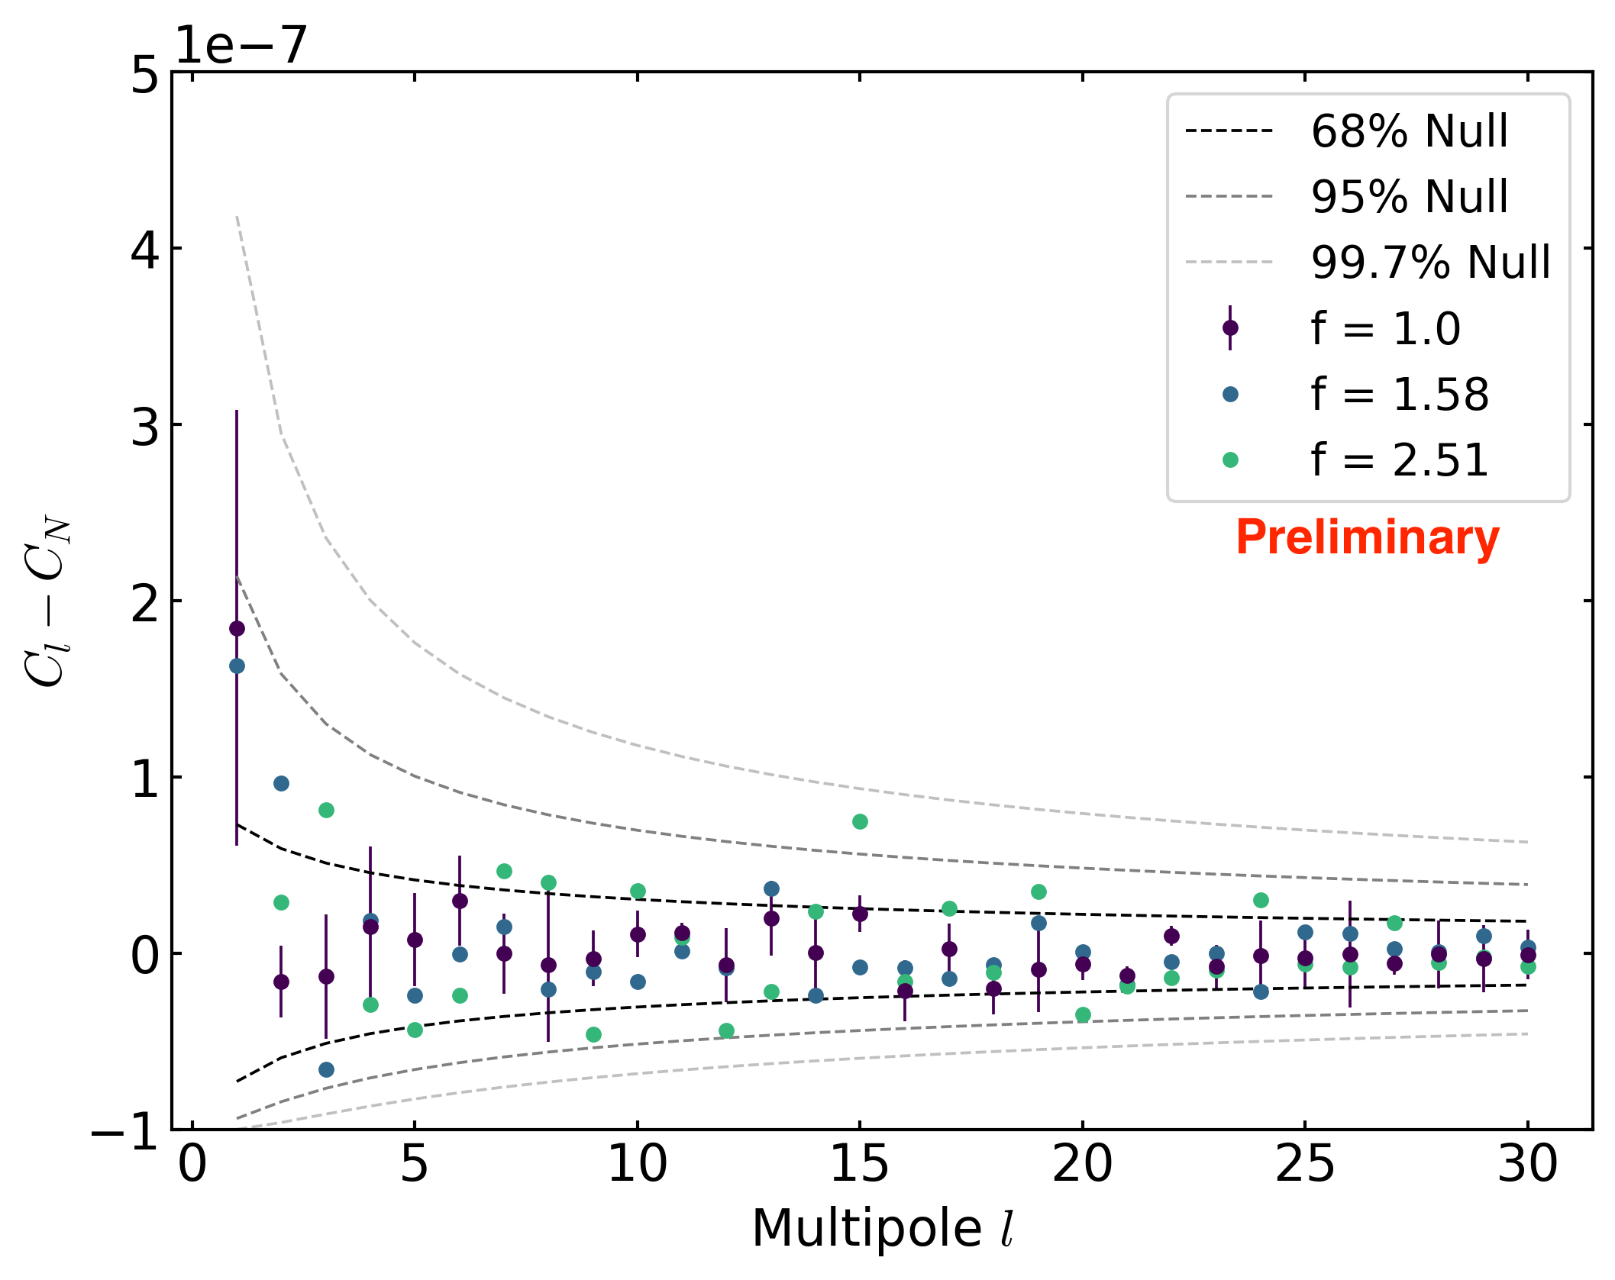
Monte Carlo investigation of geomagnetic rate effect
zoomed out
zoomed in
Monte Carlo with amplitude of rate variation scaled by factor f
For true size of effect (f=1):
  Slight excess power found in dipole
  No excess power found in quadrupole

Slide 25
Cosmic-ray electron+positron anisotropy search
also used to constrain dark matter:
Fermi LAT, PRD 84, 032007 (2011)
No anisotropy found between 42 GeV and 2 TeV
Upper limits constrain contribution from Vela (local pulsar)
PRL 118, 091103 (2017)
Notes:
First analysis was:
1 year of data, 1.6M events, upper limits 0.5% to 10%
PRD 82, 092003 (2010)
Latest analysis is:
6 years of data, Pass 8, 12.2M events
Factor of 7.6 in stats
Factor of 6 in livetime
So factor of 7.6/6 = 1.27 = ~30% improvement due to Pass 8

Slide 26
Dependence of rate on McIlwain L in 4 energy bins
arXiv:1903.02905
Significant rate variation in lowest energy bins; not in highest
Notes:
Figure 11. Third-degree polynomial fits of the relative event rate in four energy bins. The eight analysis energy bins are combined to yield similar event statistics in each com- bined bin. The relative rate is the total eight-year event rate in each McIlwain L bin divided by the average rate across all McIlwain L bins.

Slide 27
Monte Carlo investigation of McIlwain-dependent rate effect
arXiv:1903.02905
Effect causes a very small amount of excess power a large angular scales
Not enough to explain the dipole power in LAT results
Small effect: not accounted for in analysis
Notes:
Figure 12. Angular power spectra from an MC study of the McIlwain L-dependent event rate for event with energy greater than 78 GeV. Ten simulated data sets were gener- ated using the McIlwain L-dependent rates in Figure 11 and processed with the anisotropy pipeline. The data points are the mean angular power at each multipole from the ten re- alizations and the error bars, which are hardly visible, are the standard error on the mean. The dashed lines represent the 1σ spread among the ten realizations. The colored bands represent the distribution of expected results under the null hypothesis, i.e., isotropic sky.

Slide 28
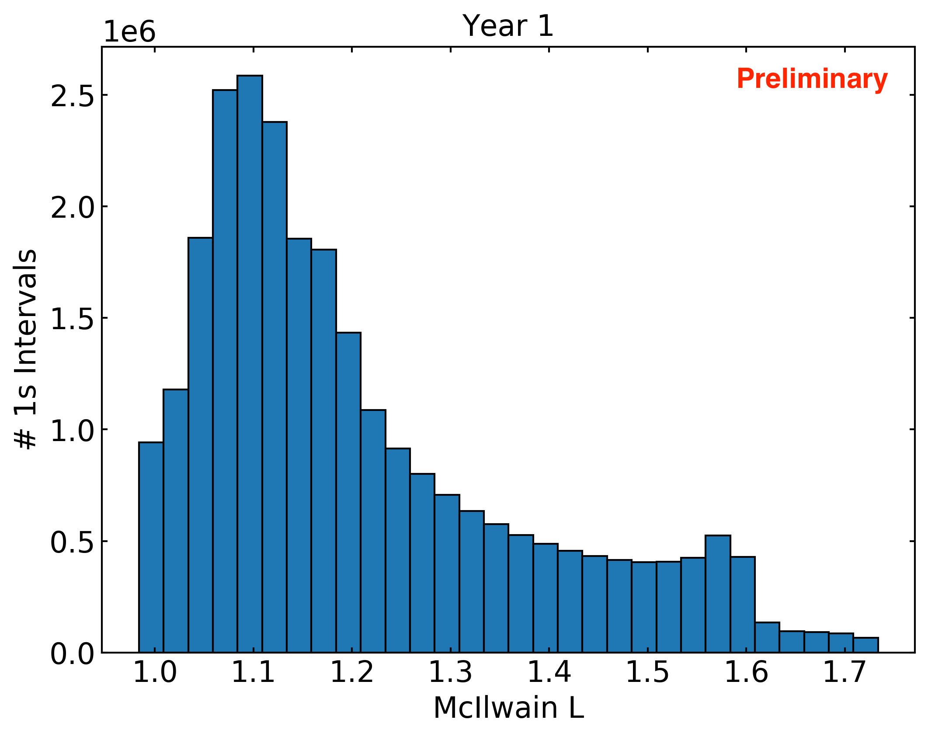
Distribution of LAT geomagnetic position (McIlwain L)

Slide 29
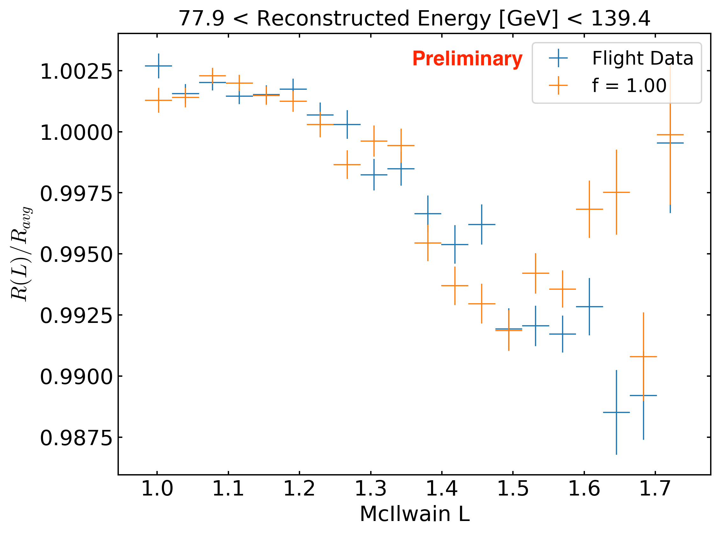
Monte Carlo investigation of rate effect
f is scale factor that determines amplitude of rate variation

Slide 30
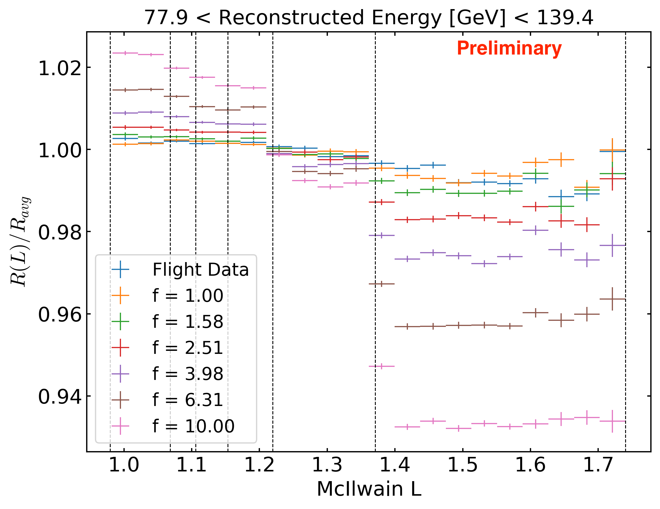
Monte Carlo investigation of rate effect
f is scale factor that determines amplitude of rate variation

Slide 31
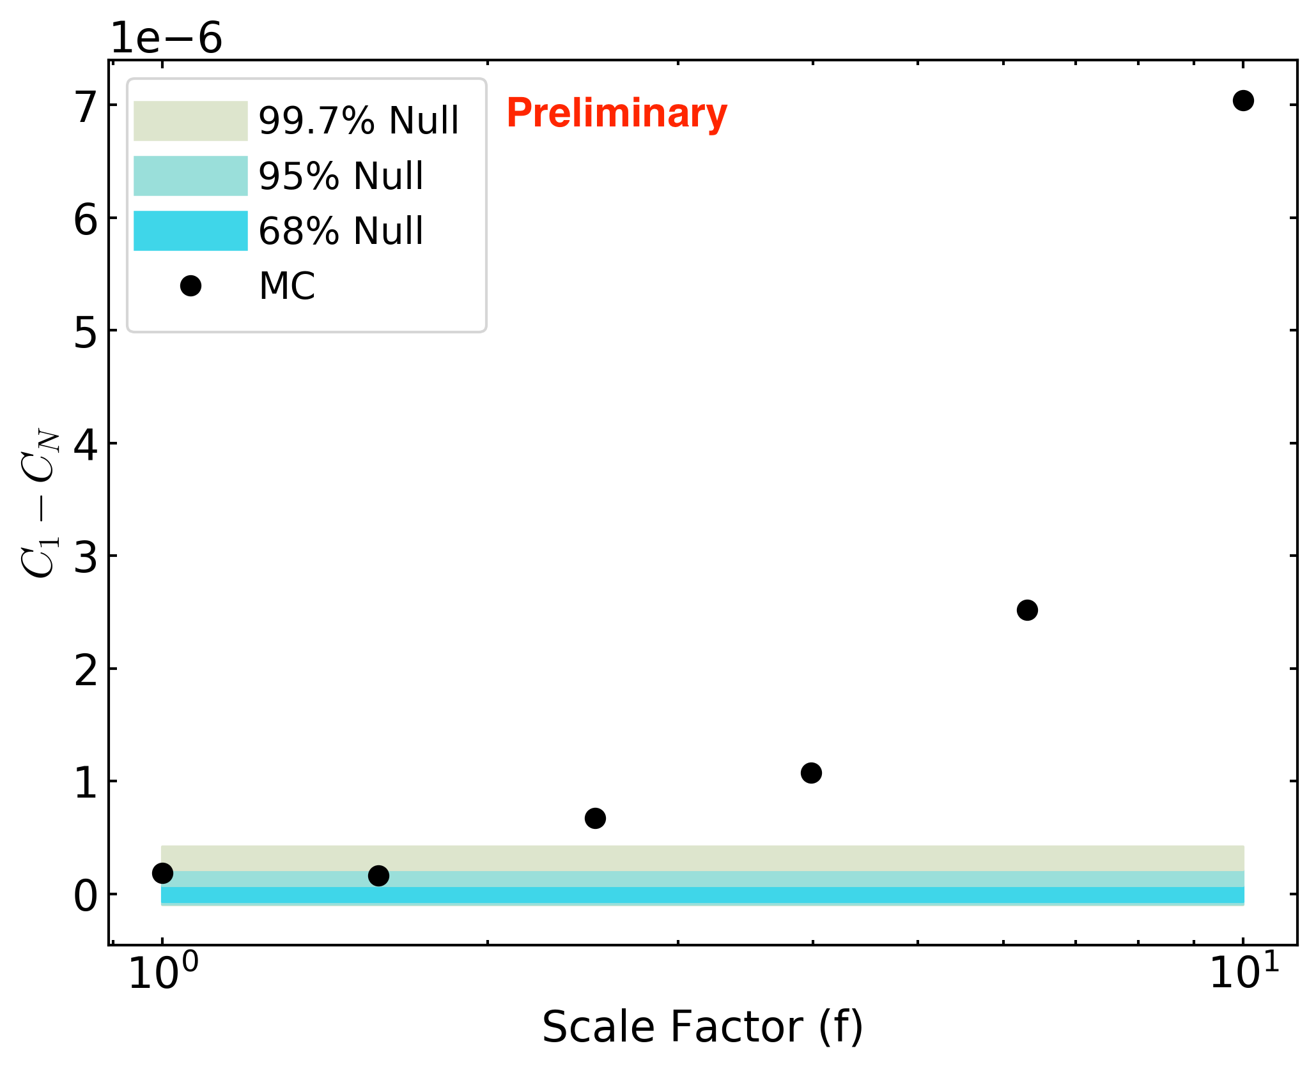
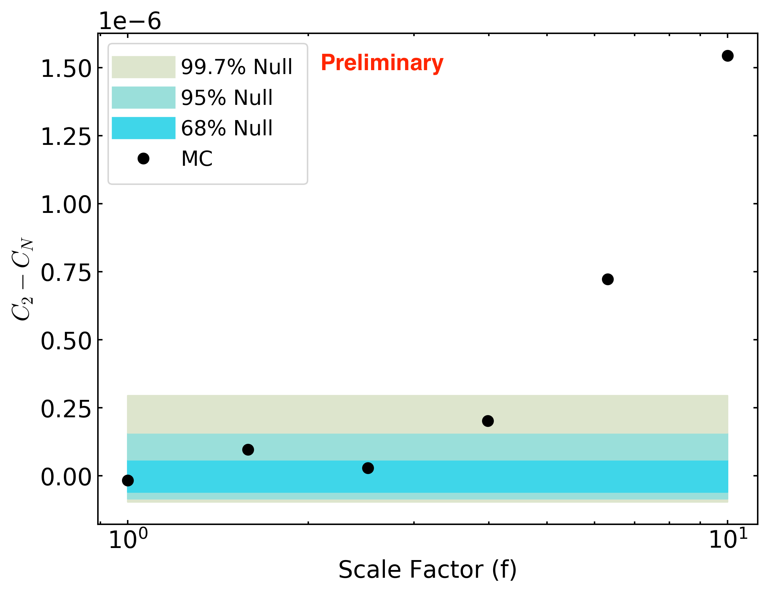
Monte Carlo investigation of rate effect
f is scale factor that determines amplitude of rate variation
For true size of effect (f=1):
  Slight excess power found in dipole
  No excess power found in quadrupole

Slide 32
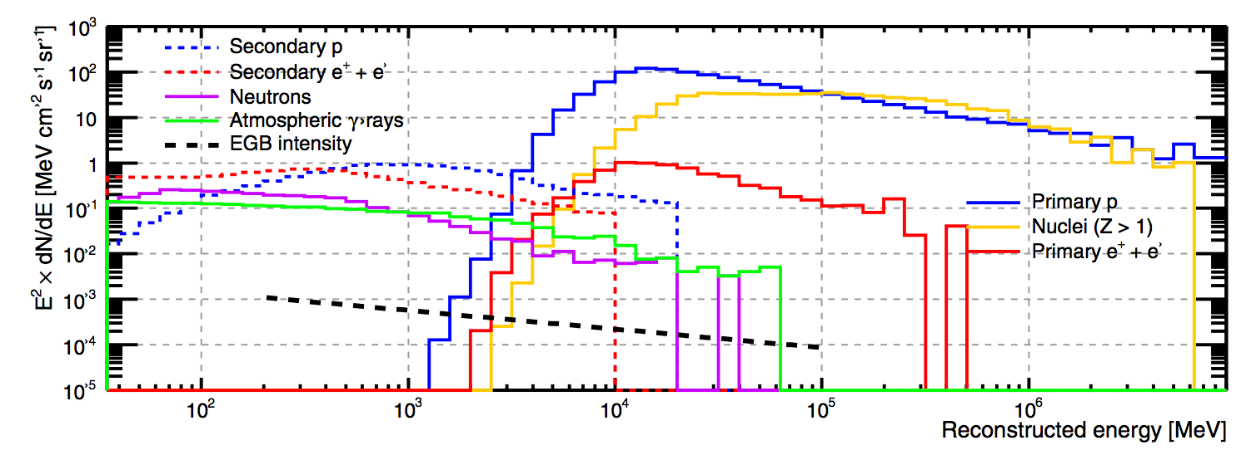
Particle spectra at Fermi LAT
Fermi LAT, ApJS 203:4 (2012)

Slide 33
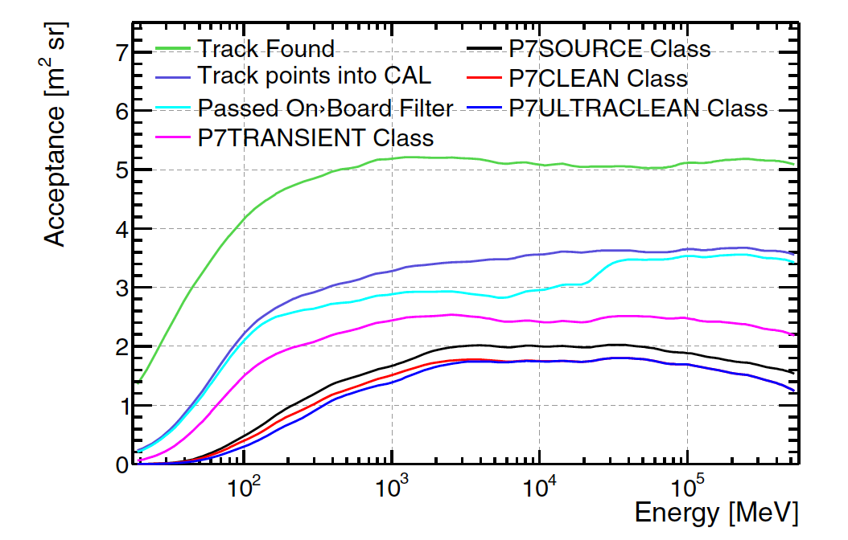
Fermi LAT gamma-ray acceptance (Pass 7)
Fermi LAT, ApJS 203:4 (2012)

Slide 34
Fermi LAT proton energy spectrum
David Green for Fermi LAT, ICRC 2017

Slide 35
Fermi LAT proton acceptance (Pass 8)
David Green for Fermi LAT, ICRC 2017

Slide 36
Fermi LAT proton statistics
David Green for Fermi LAT, ICRC 2017

Slide 37
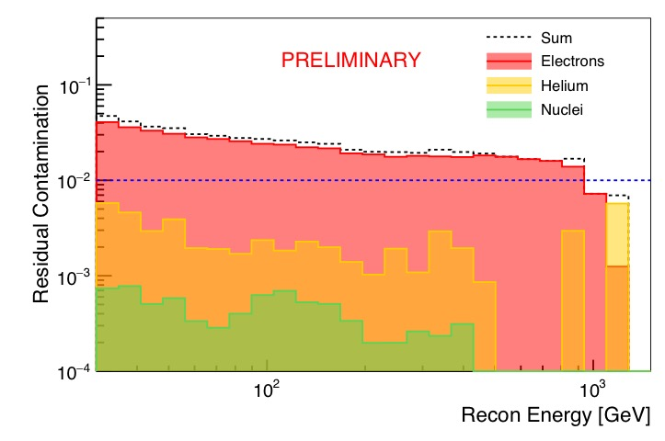
Contamination by other species in proton selection
David Green for Fermi LAT, ICRC 2017

Slide 38
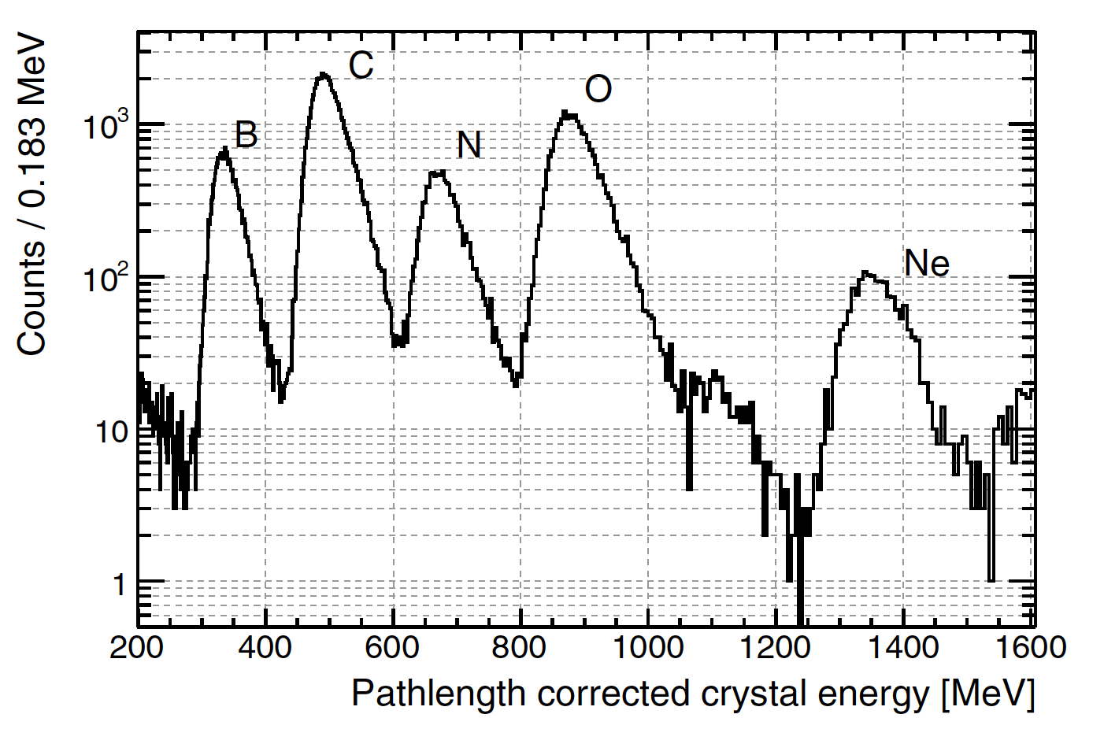
Heavy ions: charge resolution
flight data
Fermi LAT, ApJS 203:4 (2012)
Notes:
Figure 72. Distribution of the path length-corrected crystal energy deposition
for a sample of events used to inter-calibrate the low-energy and high-energy
CAL energy ranges. The peaks corresponding to the most abundant Galactic
CR species are clearly visible, though the composition differs somewhat from
the Galactic CRs because of secondary production in the ACD and TKR.
Ne: Z=10
dE/dx scales as Z^2 (Bethe-Bloch)
B/Ne Z ratio: 5/10 so 2^2 = expected ratio of 4
Actual ratio is 1350 / 350 = 3.9

Slide 39
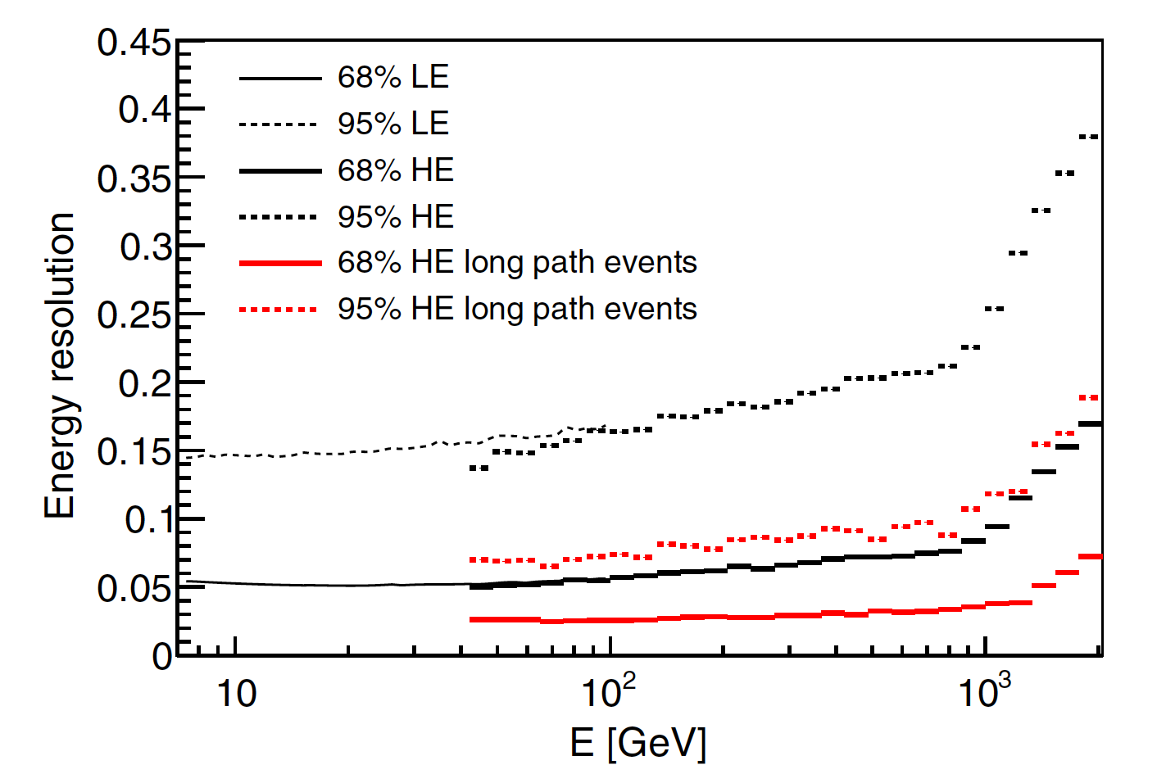
Cosmic-ray electron energy resolution
Fermi LAT, PRD 95 082007 (2017)

Slide 40
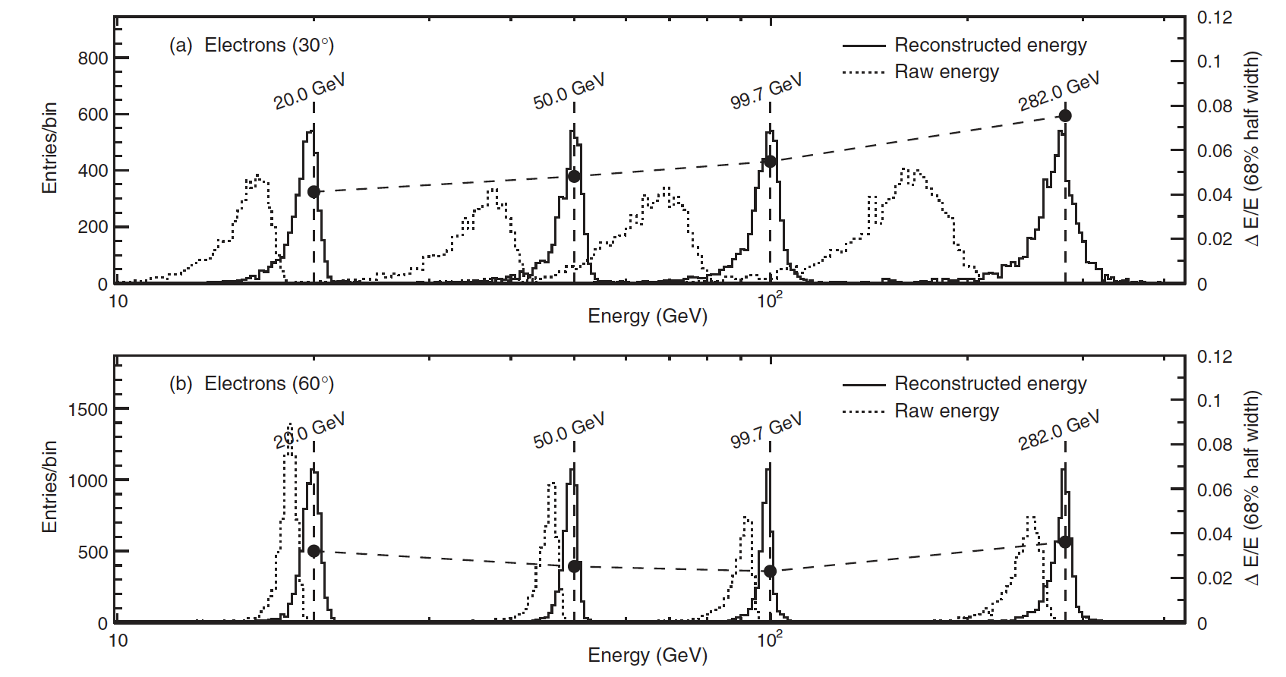
Cosmic-ray electron energy resolution
Fermi LAT, PRD 82, 092004 (2010)

Slide 41
Electromagnetic shower maximum: back of the envelope
What is maximum gamma or electron energy for which Xmax is contained within 10 radiation lengths?
t_{max} = X_{max}/X₀ = ln(E₀/E_{crit})/ln(2)
ln(2)*t_{max} = ln(E₀/E_{crit})
When does t_{max} = 10?
If Ecrit = 40 MeV (silicon),
  exp(6.9 ) = E₀/E_{crit}
  E₀ = E_{crit}*1022 = ~40 GeV if 10 radiation length pure Si
  Also tungsten
CAL (CsI) Ecrit = 11 MeV
  E₀ = ~10 GeV if 10 radiation length pure CAL
Notes:
http://pdg.lbl.gov/2016/AtomicNuclearProperties/critical_energy.html

Slide 42
Impact of quality cut on tracker-calorimeter angle
(simulation)
Notes:
Figure 9. Results of simulations of an eight-year observation with decreasing tracker-calorimeter angle thresholds. Top: The quadrupole power (C2) is plotted vs. the maxi- mum tracker-calorimeter angle used in the event selection. A significant quadrupole excess is detected at larger thresholds due to events from the PSF tail. Bottom: The l=2 coefficients of the spherical harmonic transform are plotted
vs. the maximum tracker-calorimeter angle used in the event selection. All of the excess quadrupole power seen in the plot on the left is in the m=0 moment, i.e., a20.

Slide 43
Data-driven cut on tracker-calorimeter angle
Notes:
Figure 10. Results of the scan over the tracker-calorimeter angle parameter using flight data. We scanned maximum tracker-calorimeter angle thresholds and ran the resulting data sets through the full anisotropy pipeline. To not bias the measurement of the other moments of the spherical harmonic analysis, we only used the a20 in the scan, remaining blind to the other spherical harmonic parameters.

